Slide 1
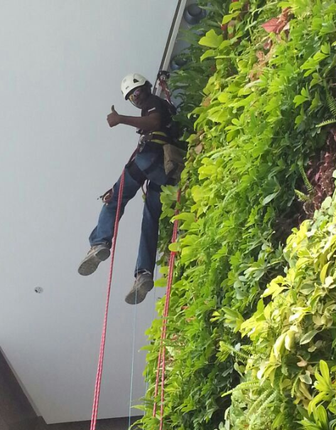
Sustainable Landscape
Design conference on 3rd March 2017
How to Maintain
SAFELY
Landscape at Height?
Philippe Girardot
Founder of Akrobat Pte Ltd

Slide 2
Sustainable Landscape
Design conference on 3rd March 2017
I/ Specificities of landscape maintenance
II/ New Architectural Challenges
-> Hazardous accesses with a risk of fall
Terraces
Planters at the edges
Vertical walls
Slopes
Steel trees ……
III/ Fall arrest Solutions implemented in Singapore
Gardens by the Bay
Changi International Airport planters
Singapore Zoo and Jurong Bird Park
Outside greeneries : condominium

Slide 3
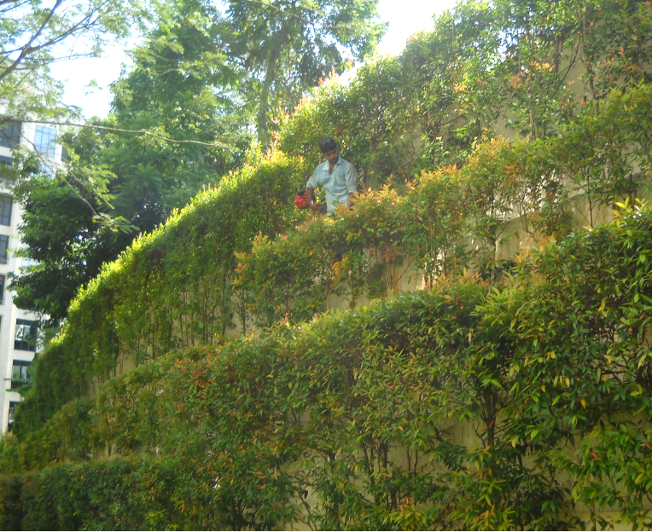
I/ Specificities of landscape maintenance
a) Plants & trees need a regular maintenance
Pruning - Watering…
Weekly – monthly basis
Hand free system
System must be EASY to use
by non specialists at height

Slide 4
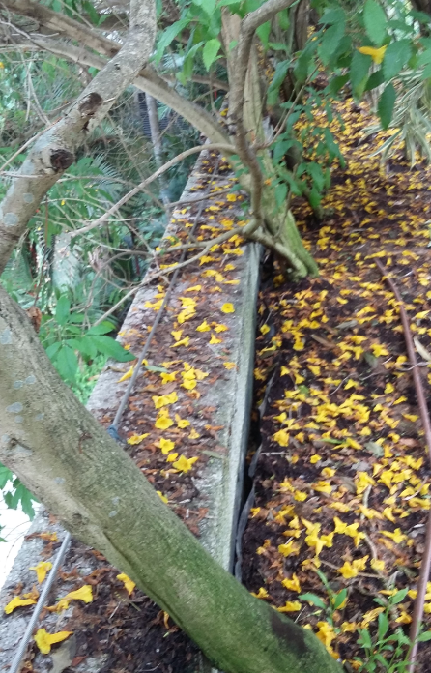
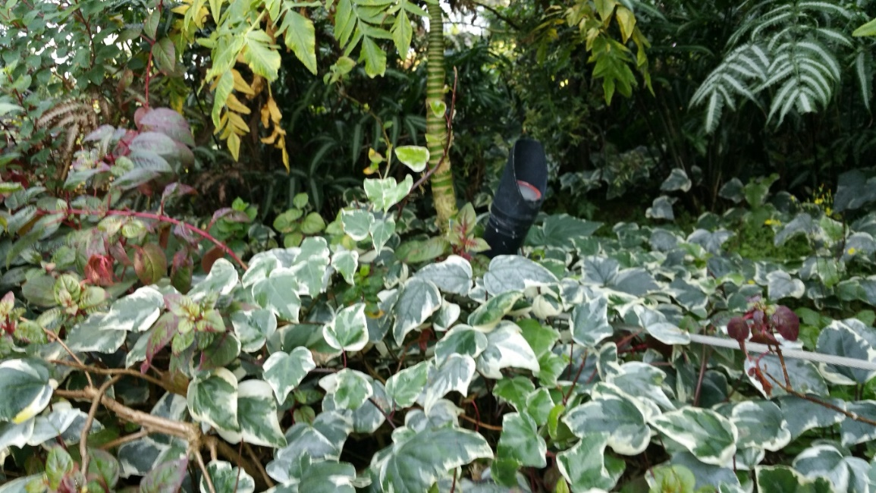
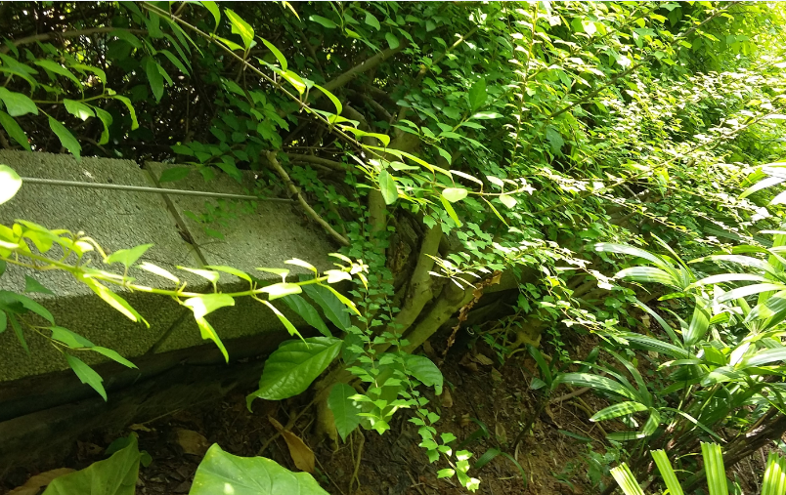
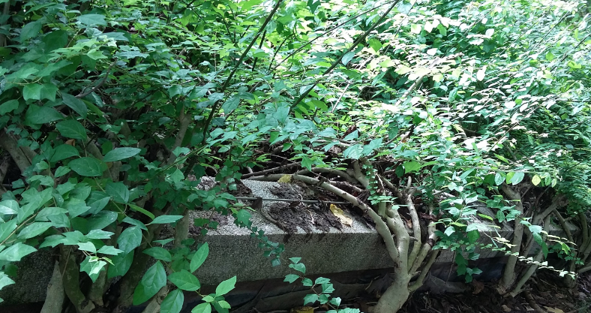
I/ Specificities of landscape maintenance
b) Plants & trees grow
Lifeline

Slide 5
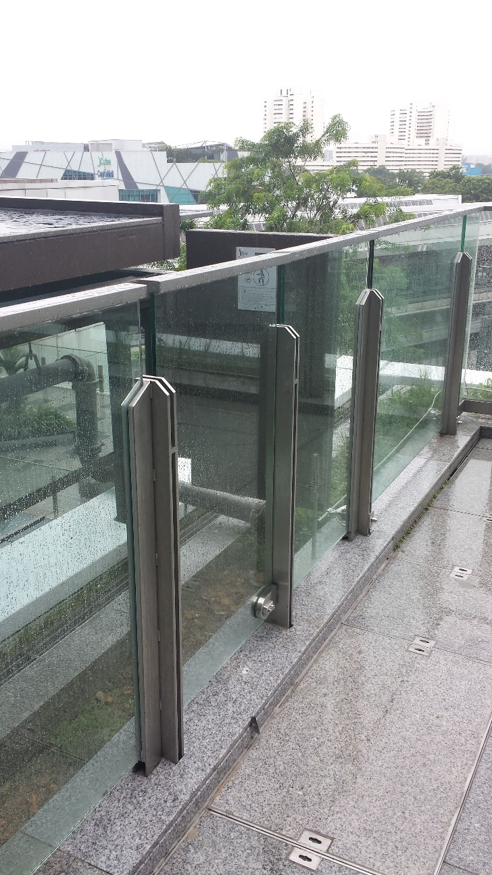
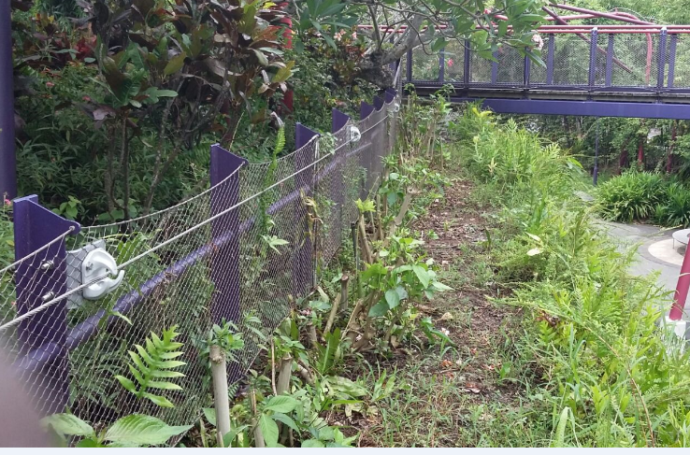
I/ Specificities of landscape maintenance
c) aesthetic

Slide 6
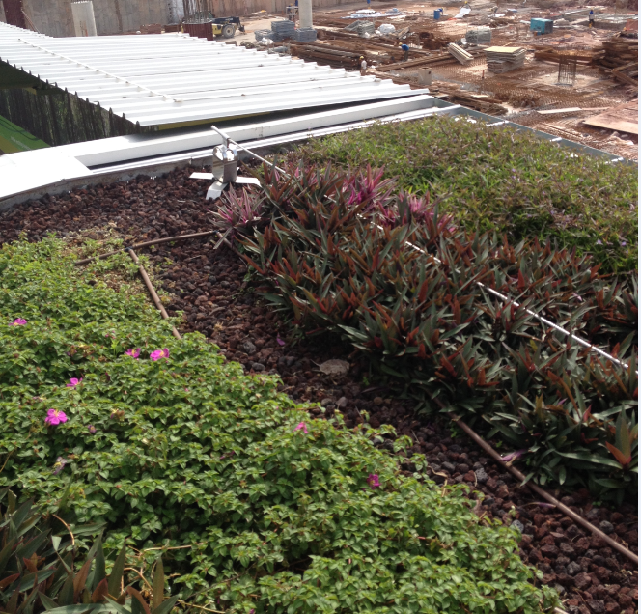
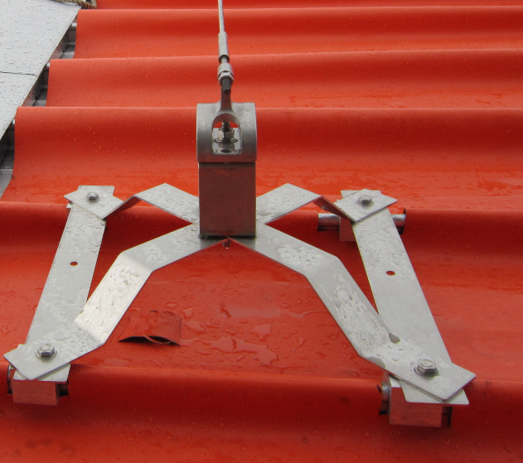
I/ Specificities of landscape maintenance
d) waterproofing
e) Soil : soft support

Slide 7
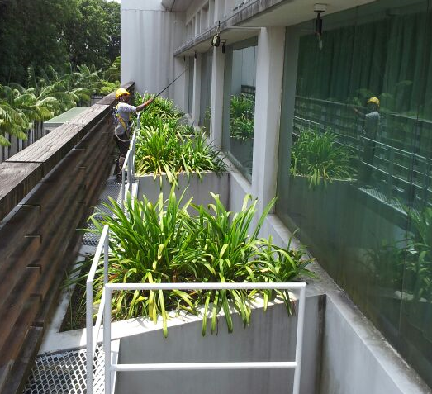
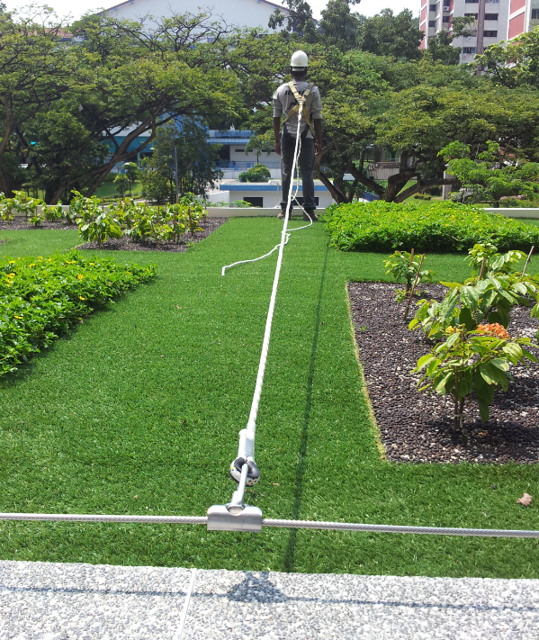
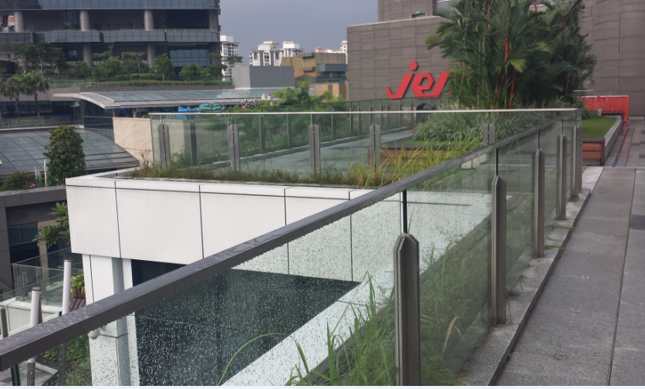
II/ New Architectural Challenges
-> Hazardous accesses with a risk of fall
a) Terraces

Slide 8
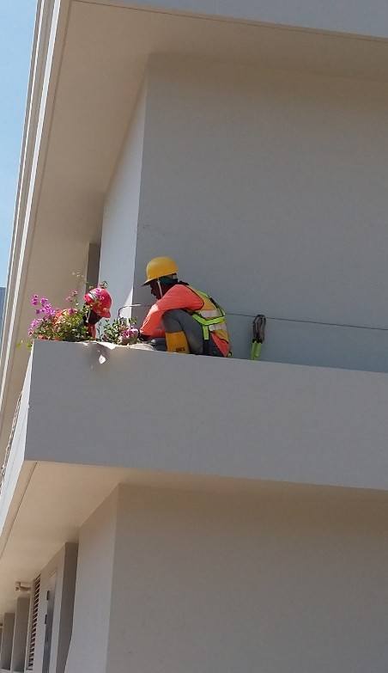
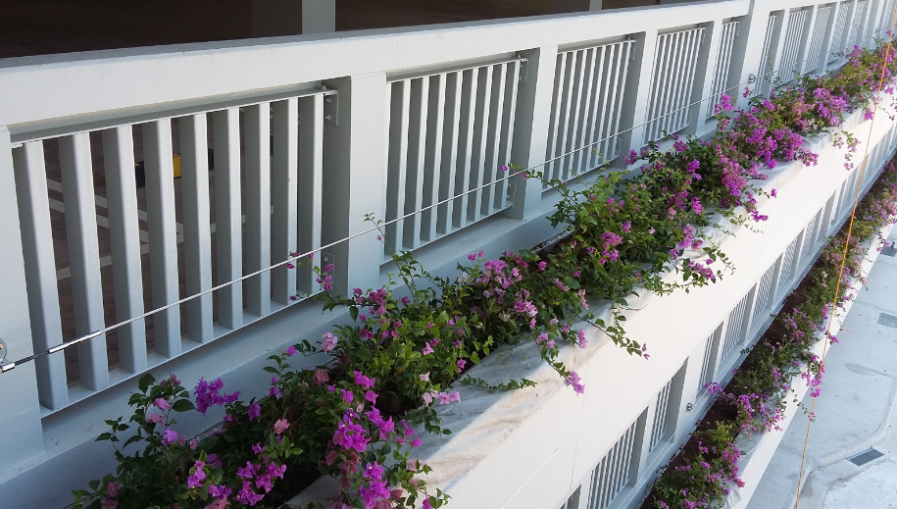
II/ New Architectural Challenges
b) Planter at the edge

Slide 9
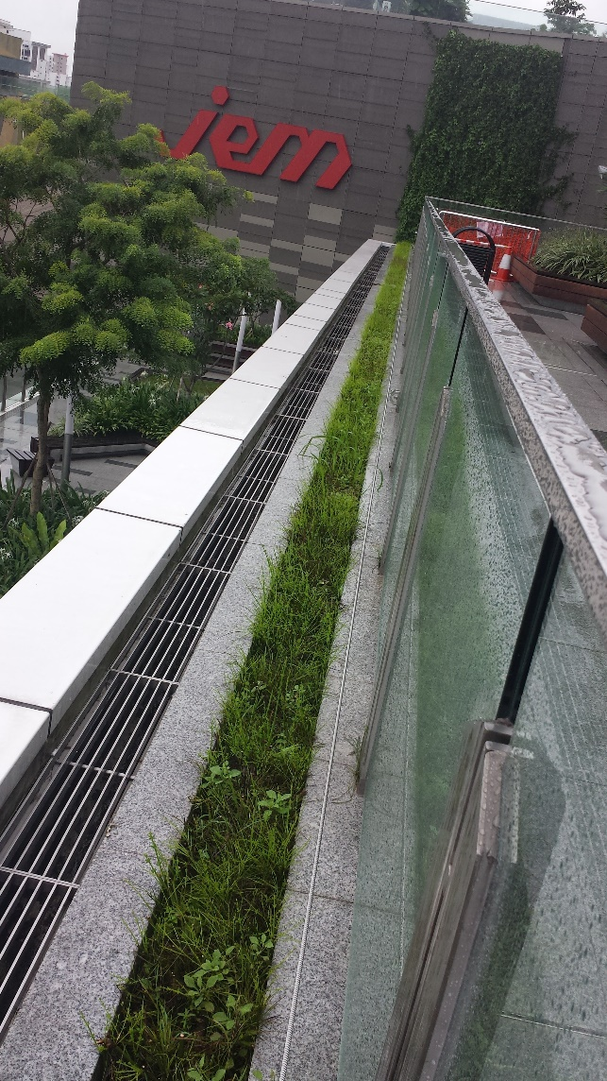
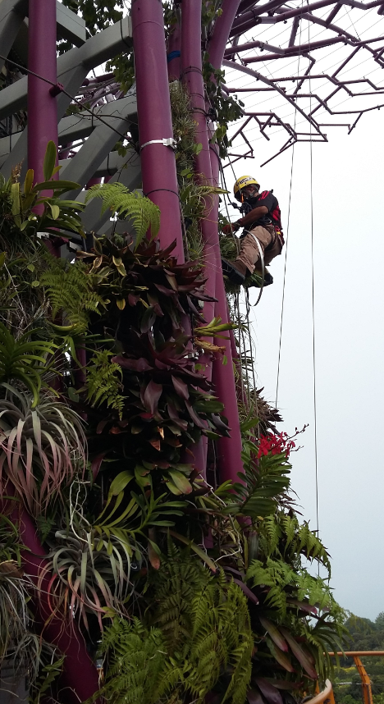
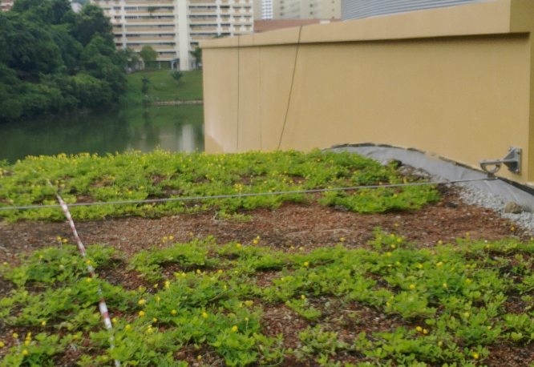
II/ New Architectural Challenges
c) Green wall
d) Roofs
c) Other fanciest…

Slide 10
III/ FALL ARREST SYSTEMS PROPOSED IN SINGAPORE
Lifeline
Wall, Parapet, RC roof
Metal roof without penetration
Overhang / mixed lifeline : Zoo, Bird Park, Garden by the Bay
Anchor points
conventional
Custom made : ground anchor, circling, davits
Deadweight anchors
Overhang Monorail
With SRL
With ladders & attachment from ground
For Rope access – option rope climber – vertical green walls
Gantries : traveling Ladders

Slide 11
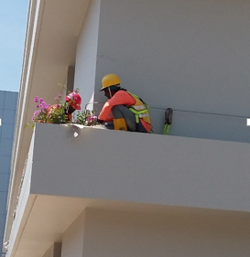
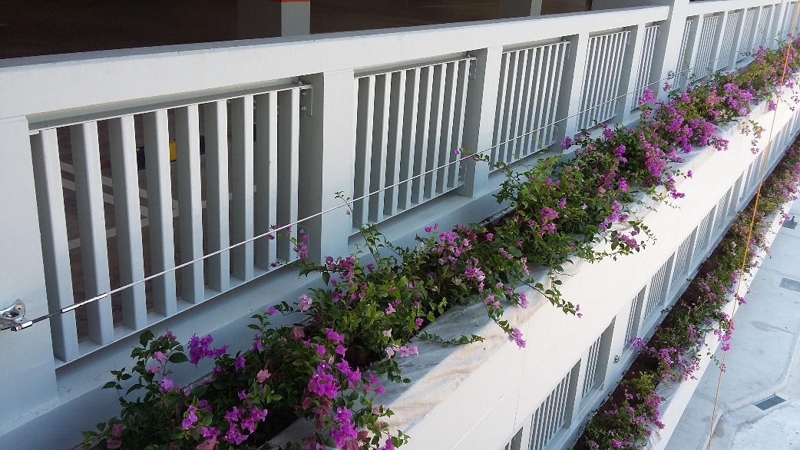
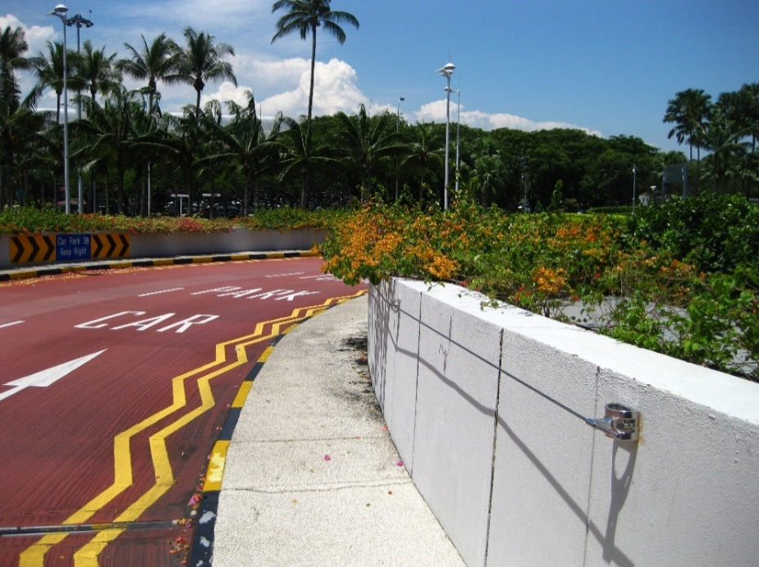
III/ FALL ARREST SYSTEMS PROPOSED IN SINGAPORE
Planters – Lifeline systems
PRINCIPLE :
Wire lifeline Fixed on RC wall
Use of a Normal lanyard
Worker secure himself before climbing over the wall

Slide 12
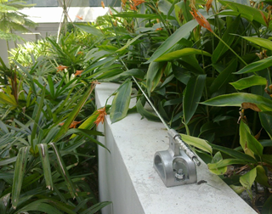
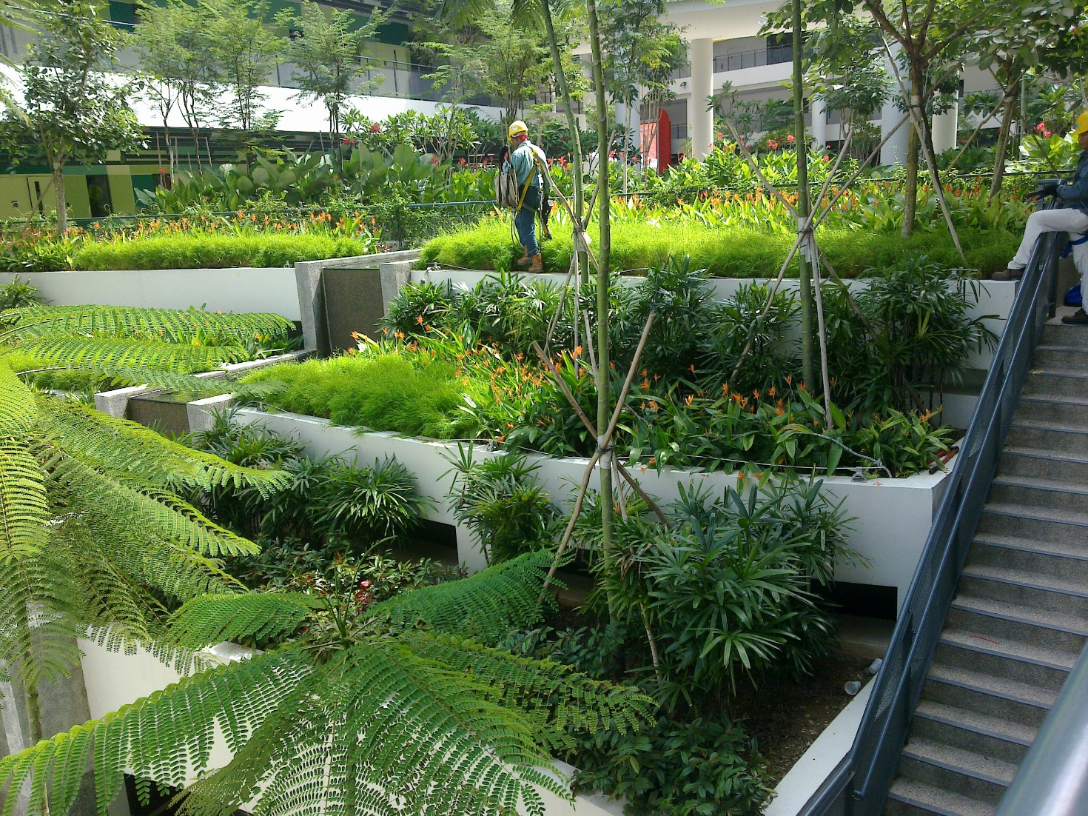
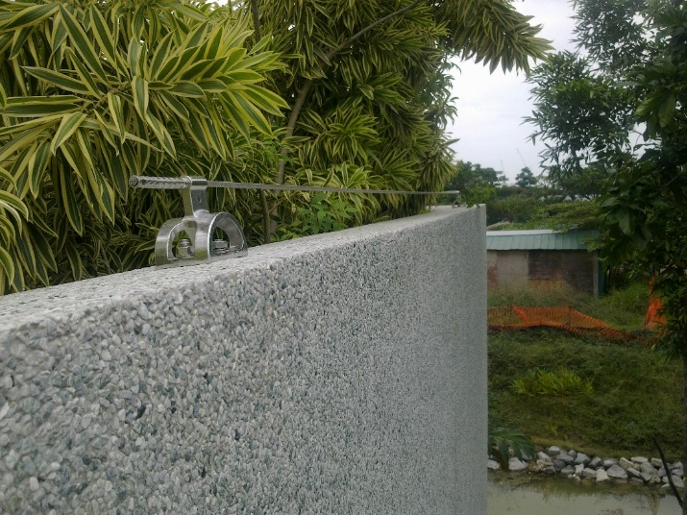
III/ FALL ARREST SYSTEMS PROPOSED IN SINGAPORE
Planters – Terraces : LIFELINE
RC walls
Strong structure

Slide 13
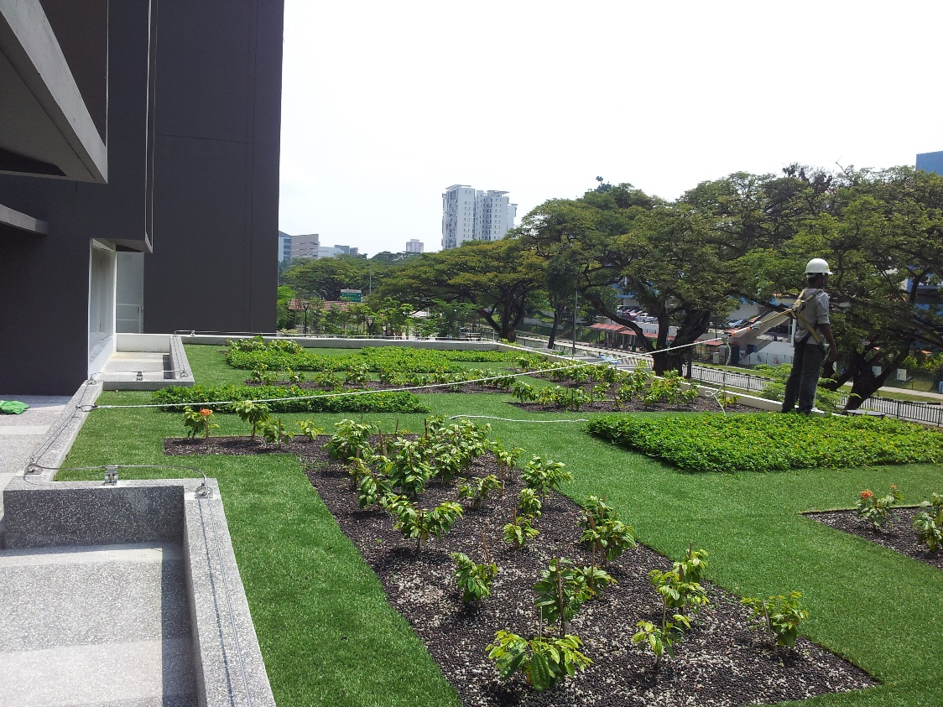
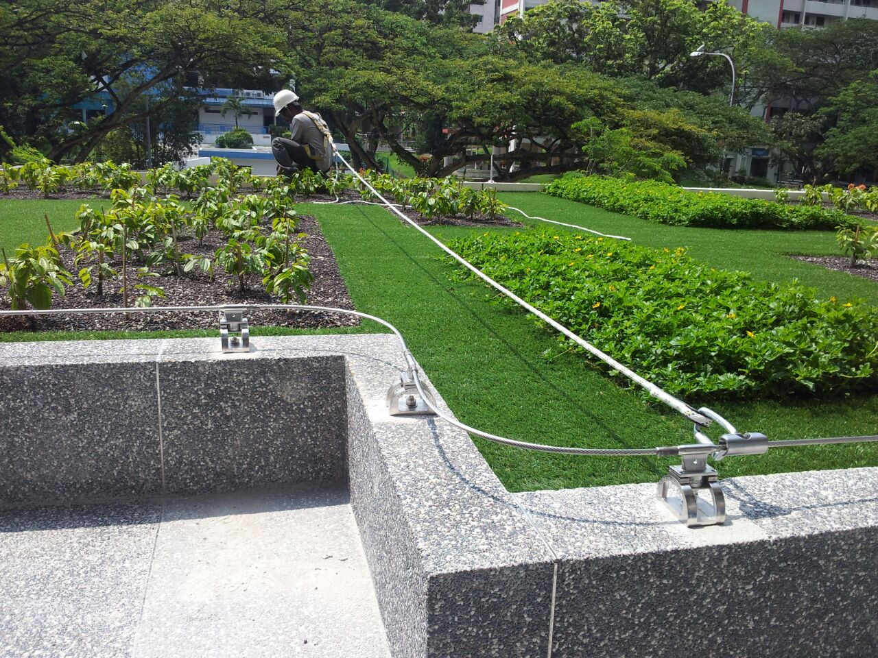
III/ FALL ARREST SYSTEMS PROPOSED IN SINGAPORE
Planters / terrace
LIFELINE on RC parapet
PRINCIPLE :
Wire lifeline Fixed on RC wall
Use of an adjustable lanyard
Worker secure himself before climbing over the wall
Passing through from distance

Slide 14
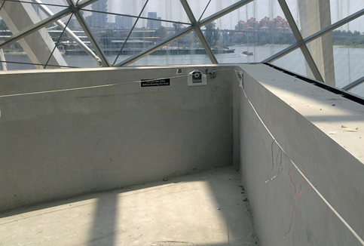
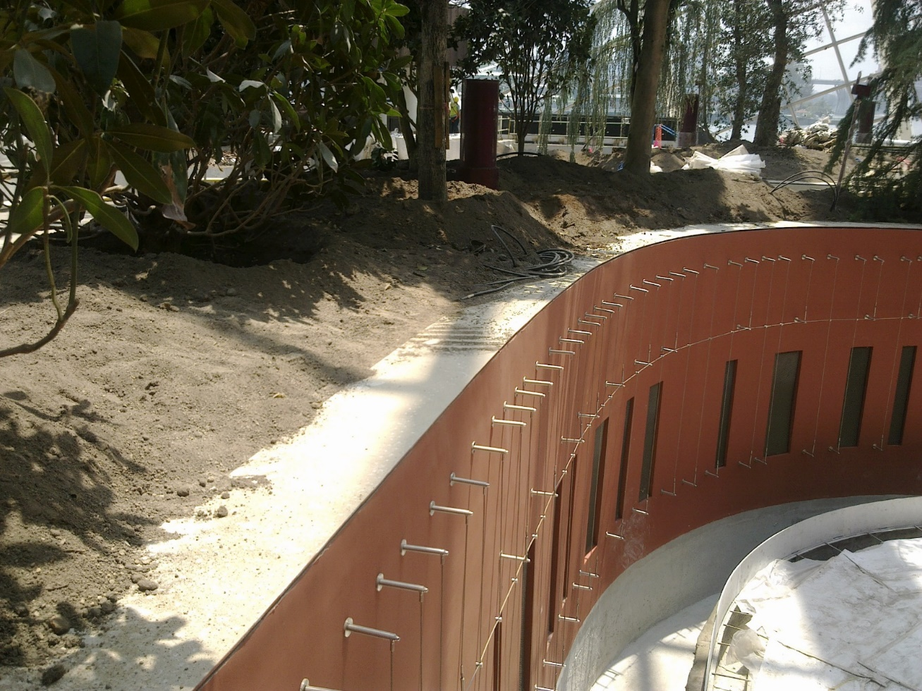
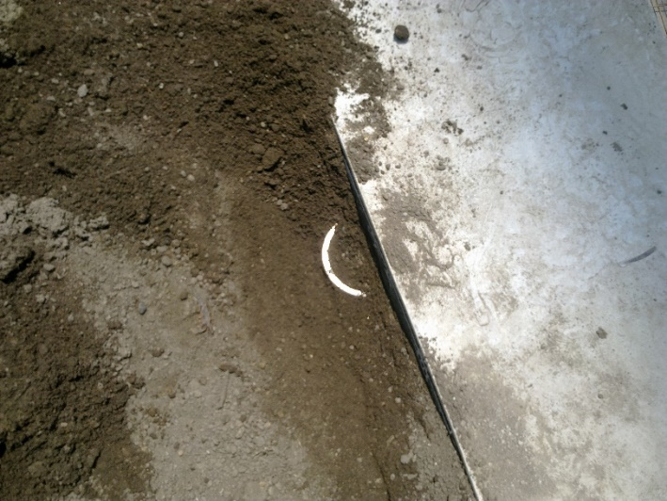
III/ FALL ARREST SYSTEMS PROPOSED IN SINGAPORE
LIFELINE
Installation without soil & plants
Soil …Lifeline at proper height
Lifeline
Lifeline
Adjustable lanyard

Slide 15
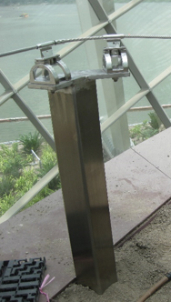
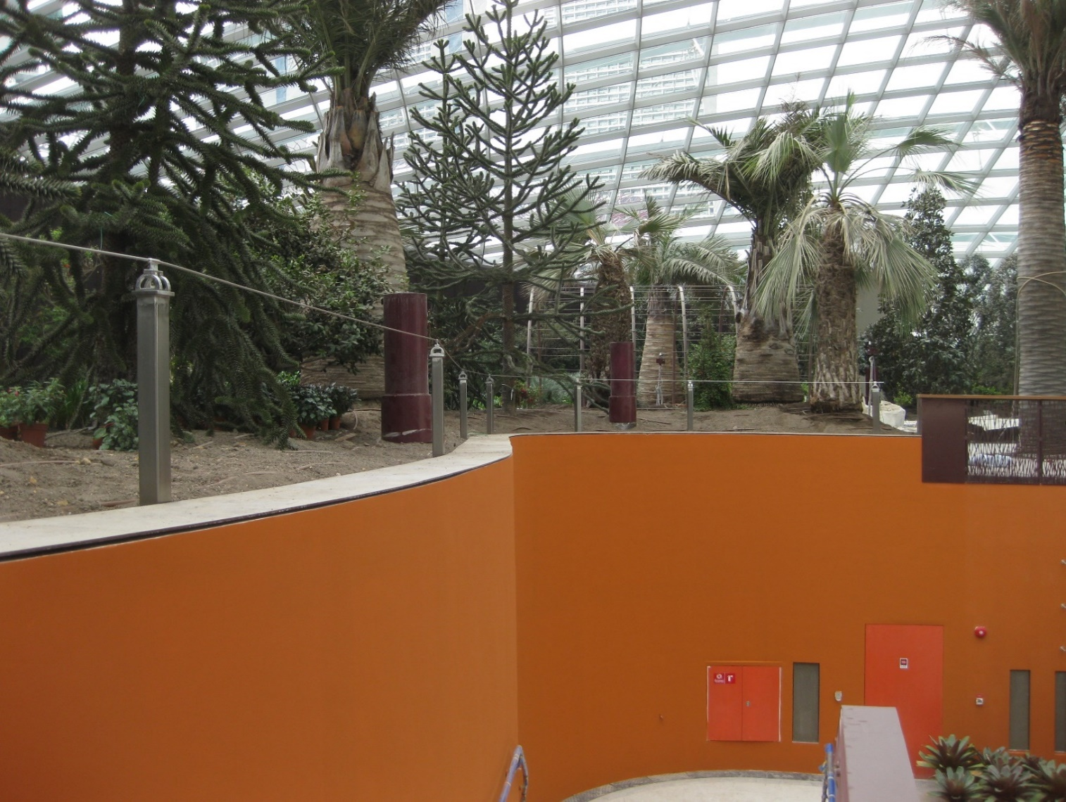
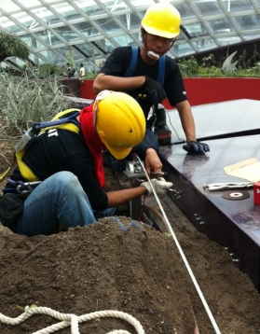
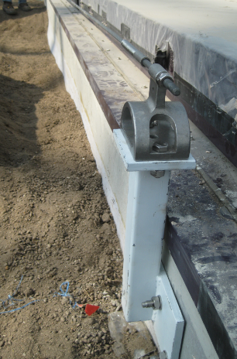
III/ FALL ARREST SYSTEMS PROPOSED IN SINGAPORE
LIFELINE WITH HIGH POSTS - GBTB
LIFELINE on RC parapet
Adjustable lanyard

Slide 16
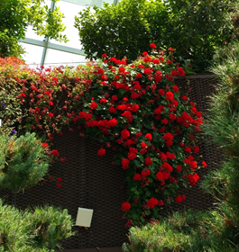
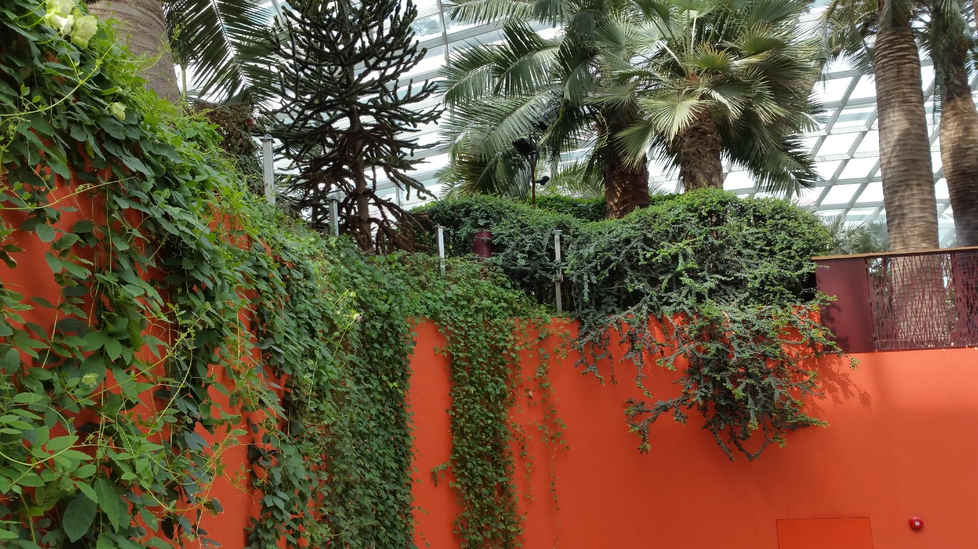
III/ FALL ARREST SYSTEMS PROPOSED IN SINGAPORE
LIFELINE WITH HIGH POSTS GBTB
3 years later…
Lifeline
Lifeline

Slide 17
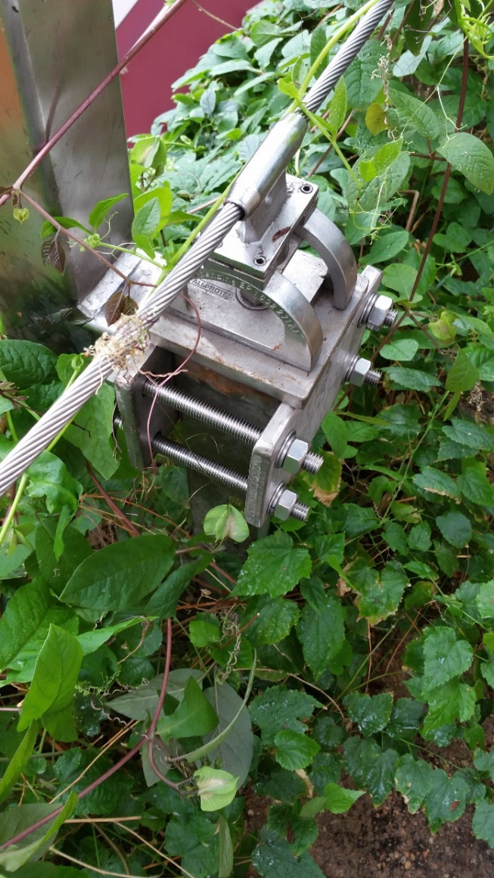
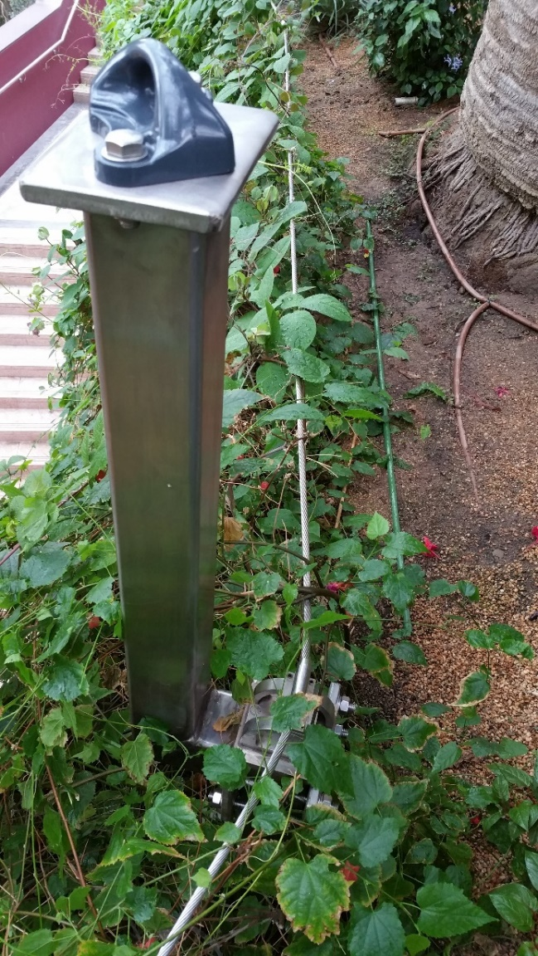
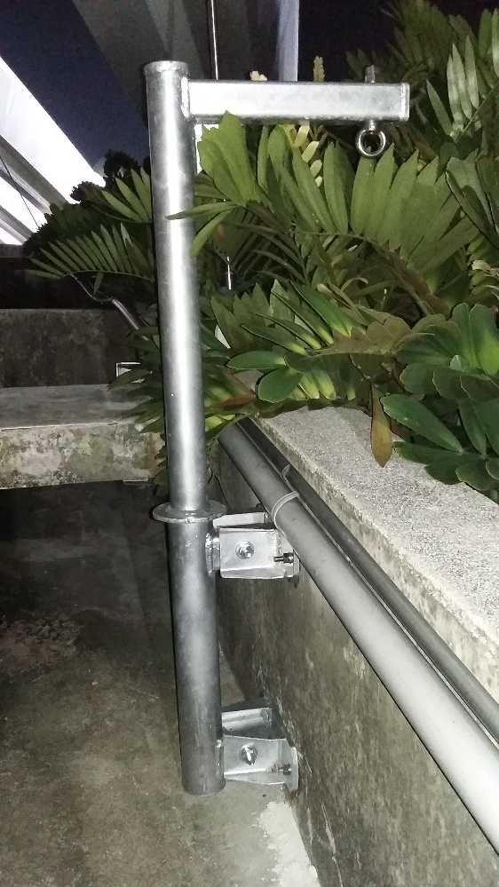
III/ FALL ARREST SYSTEMS PROPOSED IN SINGAPORE
LIFELINE WITH HIGH POSTS - GBTB
Lifeline, anchors 1.5m higher….

Slide 18
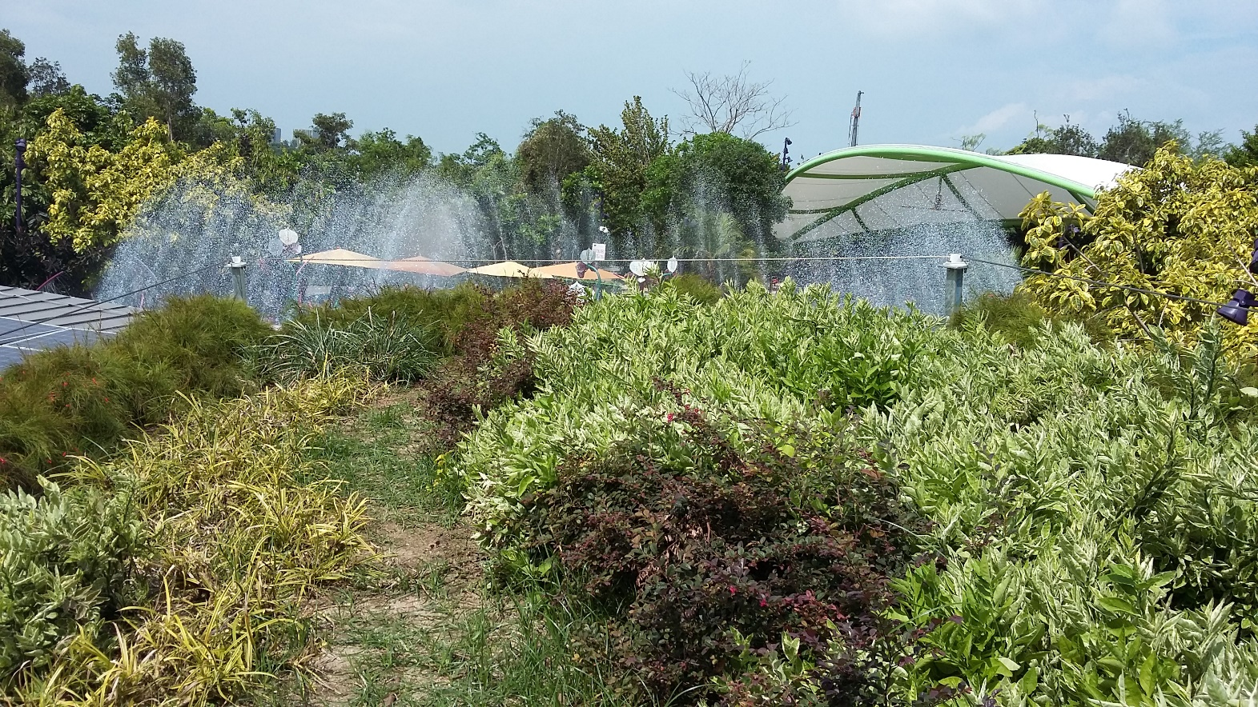
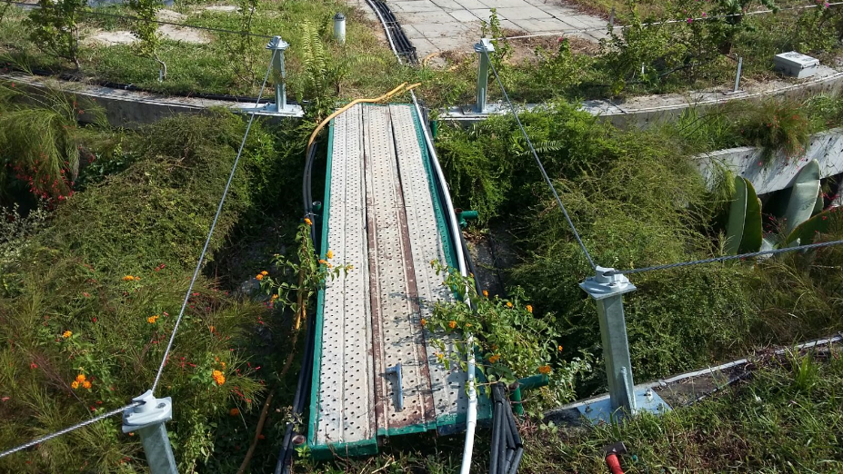
III/ FALL ARREST SYSTEMS PROPOSED IN SINGAPORE
LIFELINE
WITH HIGH POSTS

Slide 19
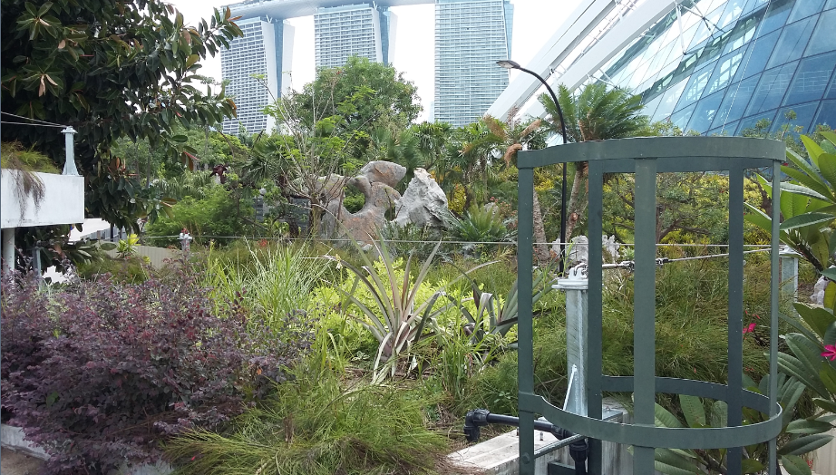
III/ FALL ARREST SYSTEMS PROPOSED IN SINGAPORE
LIFELINE WITH HIGH POSTS
Lifeline, anchors higher….

Slide 20
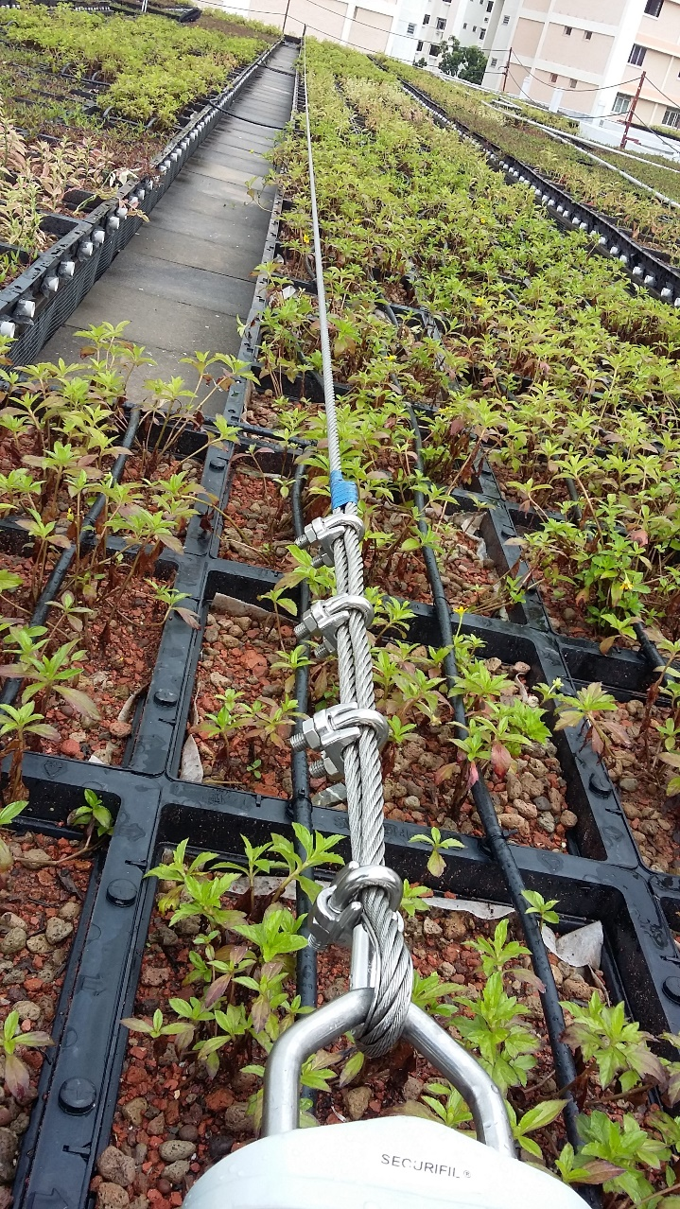
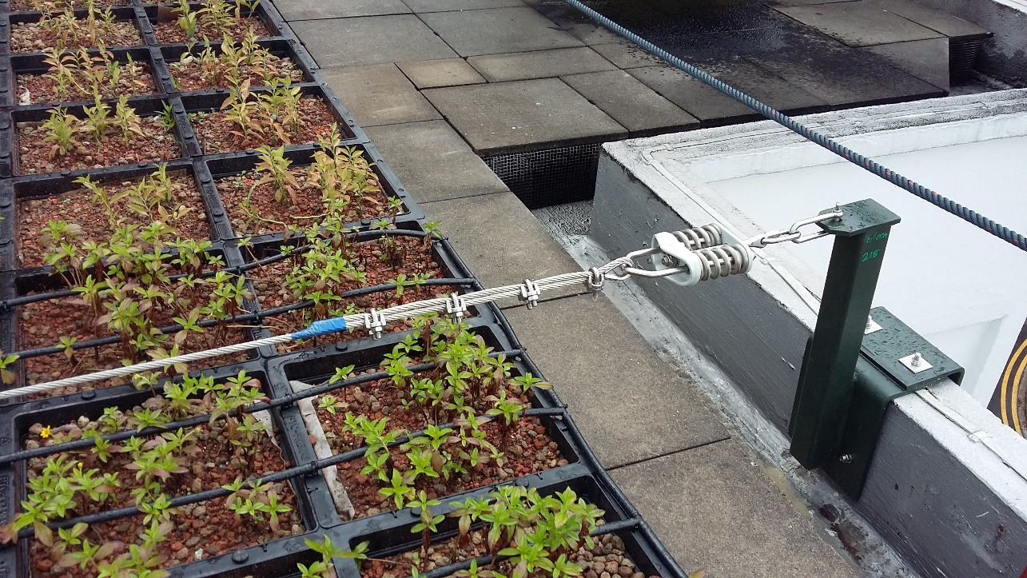
III/ FALL ARREST SYSTEMS : Roof RC
Special brackets
No drilling of the waterproofing layer

Slide 21
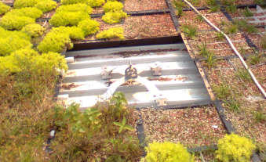
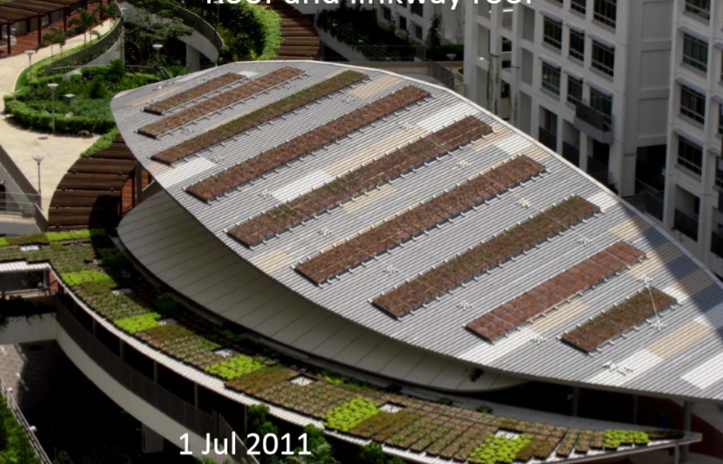
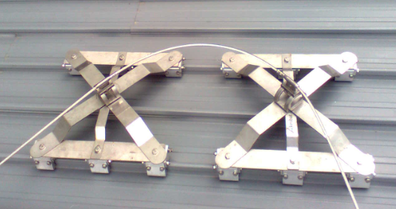
III/ FALL ARREST SYSTEMS : Metal Roof
Clamped Spider lifeline
No roof penetration
LIFELINE ON METAL ROOF – clamping
Precinct pavilion punggol

Slide 22
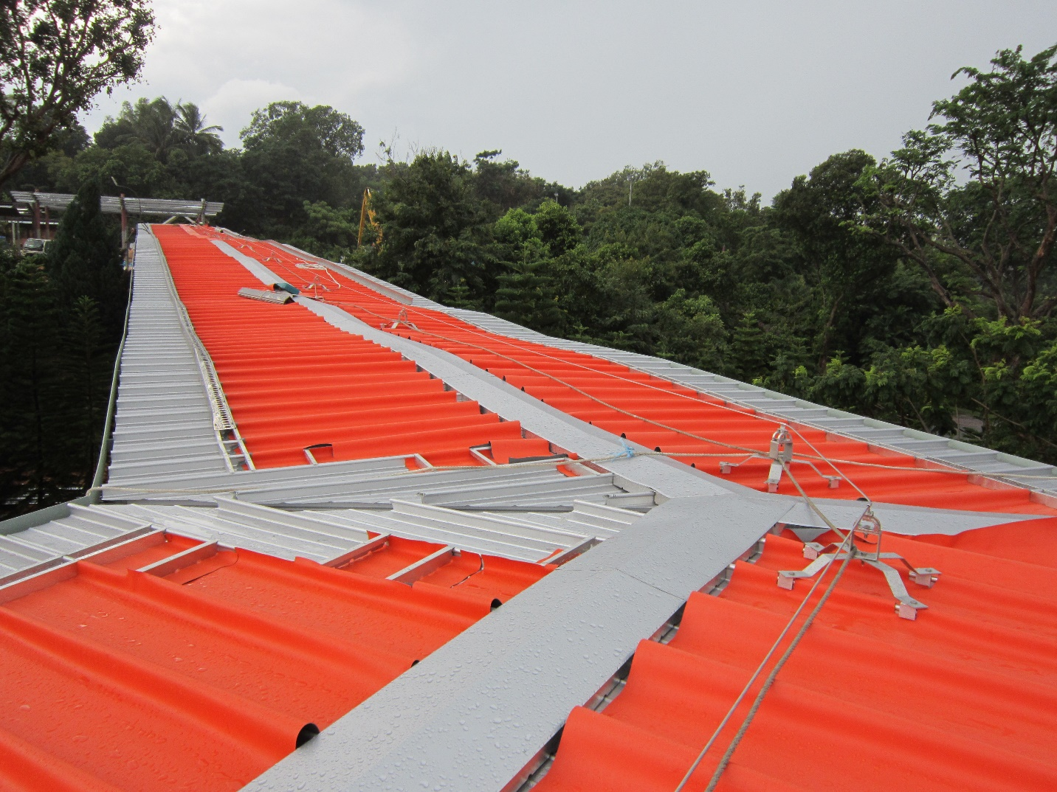
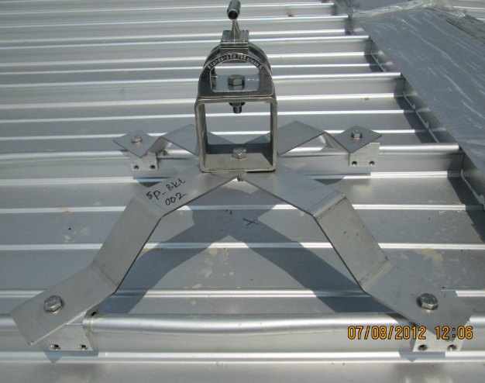
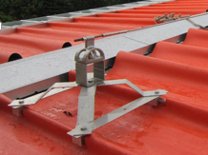
III/ FALL ARREST SYSTEMS : Metal Roof
LIFELINE ON METAL ROOF – clamping
Clamped Spider lifeline
No roof penetration
Sentosa Beach bridge

Slide 23
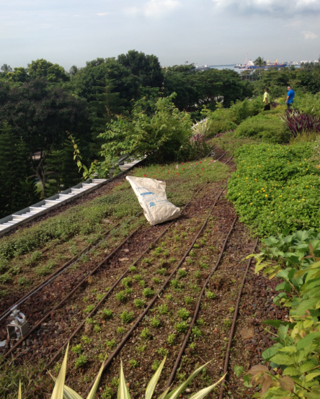
III/ FALL ARREST SYSTEMS : Metal Roof
LIFELINE ON METAL ROOF – clamping
Sentosa Beach bridge

Slide 24
III/ FALL ARREST SYSTEMS : Metal Roof
LIFELINE ON METAL ROOF – dead weight
No penetration - waterproofing
No clamping - Dead weight fixing

Slide 25
III/ FALL ARREST SYSTEMS : Metal Roof
LIFELINE ON METAL ROOF – dead weight
AFTER

Slide 26
III/ FALL ARREST SYSTEMS
LIFELINE – Leaves on roof
Overhang lifeline

Slide 27
III/ FALL ARREST SYSTEMS
LIFELINE – Leaves on roof

Slide 28
III/ FALL ARREST SYSTEMS
Anchors – for slopes
Deadweight fixed

Slide 29
III/ FALL ARREST SYSTEMS
Anchors for slopes
Custom made ground anchors : GBTB. Condos…

Slide 30
III/ FALL ARREST SYSTEMS
Overhang monorail
With use of SRL
Less deflection
Better traveling

Slide 31
III/ FALL ARREST SYSTEMS
Anchors for steel trees
Anchors Fixed by cercling
GBTB Super trees and Changi International Airport

Slide 32
III/ FALL ARREST SYSTEMS
Anchors for steel trees
Telescopic pole with carabiner
Attach the carabiner and the vertical lifeline to the anchor
Climb safely with ladder fixed and secured to the vertical lifeline

Slide 33
III/ FALL ARREST SYSTEMS
Overhang monorail with ladders
Safe way to prune vertical walls

Slide 34
III/ FALL ARREST SYSTEMS
Overhang monorail with ladders
Principle
Step 3
Climb safely with ladder fixed and secured to the vertical lifeline
Step 1
Attach the vertical lifeline from the floor
Step 2
Attach the ladder to the track by its hooks

Slide 35
III/ FALL ARREST SYSTEMS
Vertical walls : Overhang monorail for rope access
Aluminium track
Coloured
Curve along the vegetal wall

Slide 36
III/ FALL ARREST SYSTEMS
Vertical walls
Overhang monorail
for rope access
Use with motorized rope climber

Slide 37
III/ FALL ARREST SYSTEMS
Traveling ladders fixed to gondola track

Slide 38
THANK YOU
FOR YOUR ATTENTION

