Slide 1




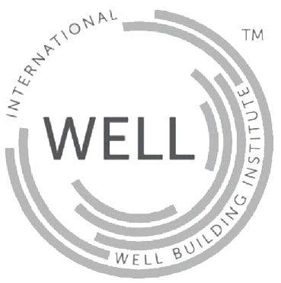

Rating Systems and Landscape Design
Technology and Sustainable Landscape Design Conference
Different Shades of Green
Dr. Naree Phinyawatana, DDes
WELL AP, LEED AP BD+C, ID+C, HOMES, TREES-A
Michael Smithing
FRICS, LEED AP ID+C, BREEAM Assessor
3rd March 2017

Slide 2

Authors
Naree Phinyawatana
WELL AP, LEED AP BD+C, ID+C, HOMES, TREES-A
Director
Atelier Ten (Asia) Pte. Ltd.
Michael Smithing
FRICS, LEED AP, ID+C, BREEAM Assessor
Director, Green Building Advisory
Europe and Asia
Colliers International

Slide 3
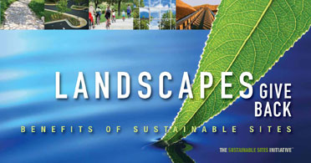
Agenda
Green Building rating systems - Green Mark, LEED, BREEAM and Green Star
Masterplan rating system - LEED for Neighborhood Development
Landscape focus - SITES and Green Mark New and Existing Parks
In-trend rating system - WELL

Slide 4
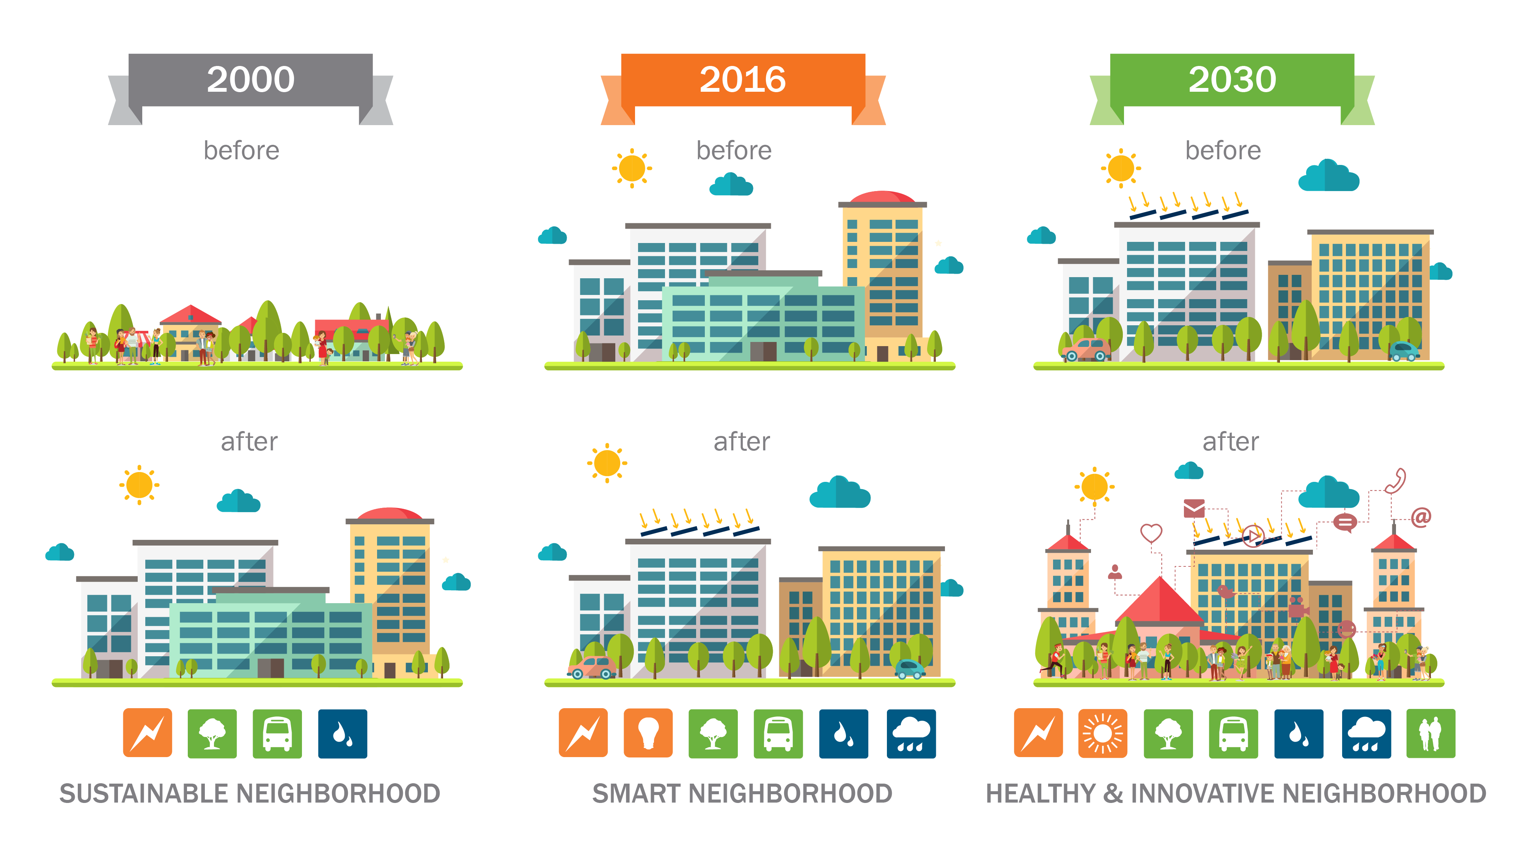
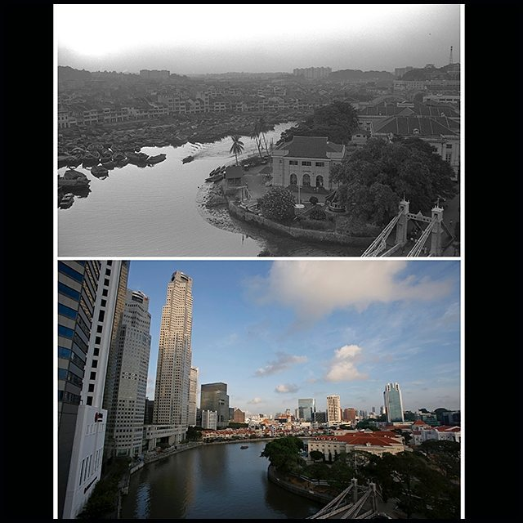

Slide 6
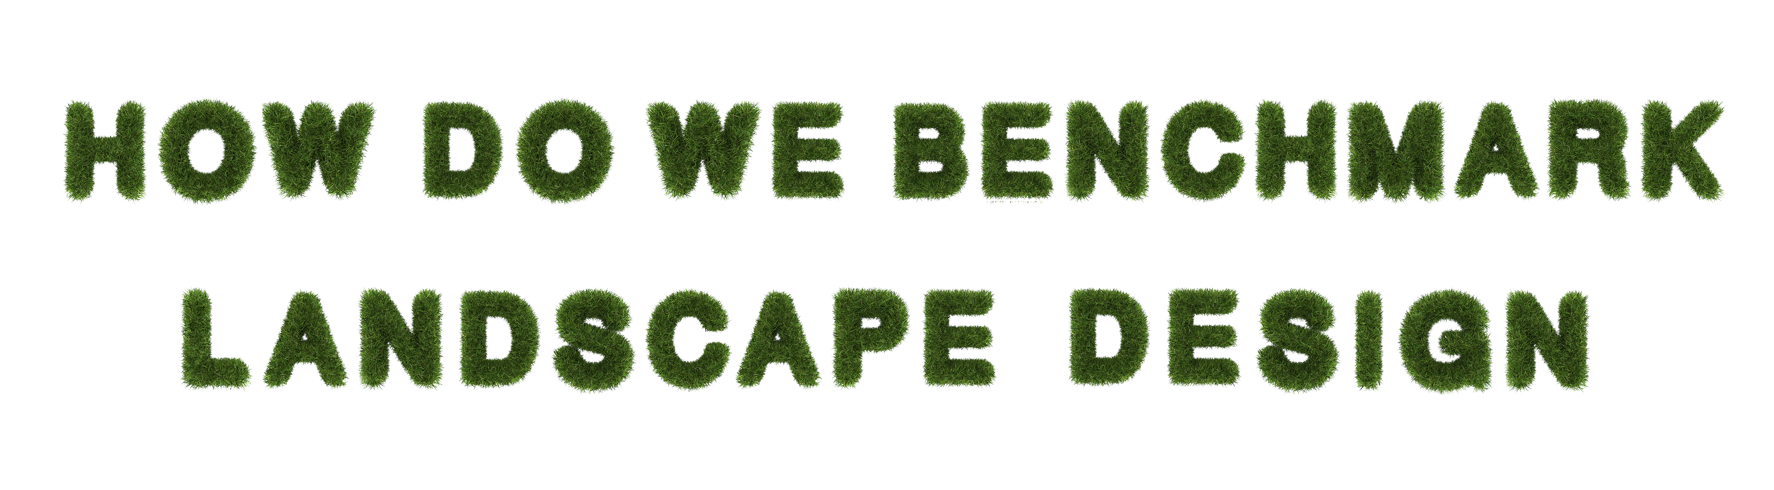

Slide 7

Goal: Improve overall sustainability of buildings
(Location, water, energy, materials, indoor environment)
Landscape impact limited
  (Stormwater, irrigation, open space, ecological impact)

Slide 8




Slide 9

% of strategies related to landscape within each rating system
8%
8%
10%
7%

Slide 10
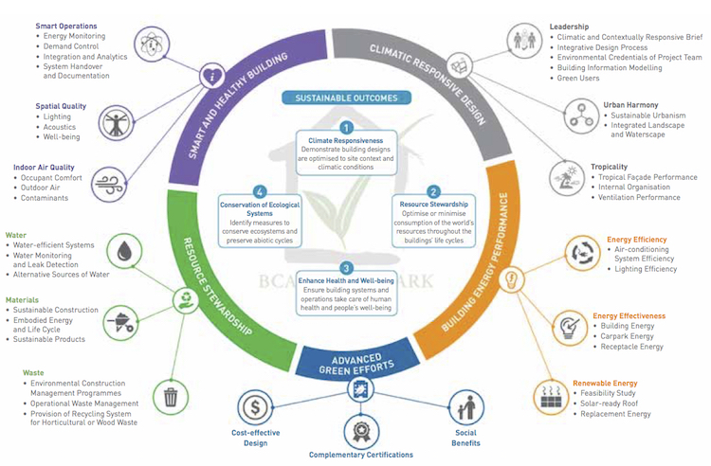


Slide 11
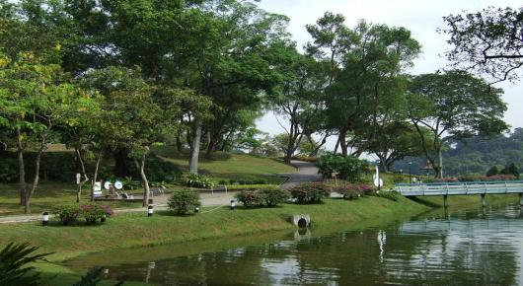
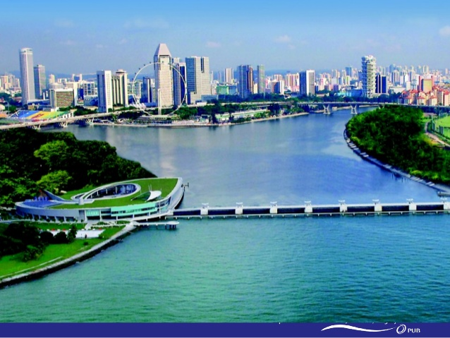
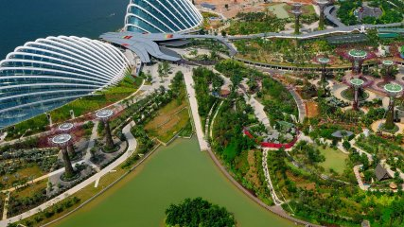
ENVIRONMENTAL ANALYSIS
ECOSYSTEMS & BIODIVERSITY
WATER& STORMWATER MANAGEMENT
LANDSCAPE
INFRASTRUCTURE

Slide 12

ENVIRONMENTAL ANALYSIS & ECOSYSTEMS & BIODIVERSITY
  Environmental study, Environmental Impact Assessment
  Create new ecology and natural ecosystems
  Site assessment considering urban context, topology, hydrology, micro-climate, access and connectivity.
  Site assessment considering topology, hydrology, climate, vegetation, soils, human use, human health effects
  Ecological protection – protect all existing features of ecological value
  Enhancing site ecology – Implement recommendations in independent on protecting and enhancing site ecology
  5 year landscape and habitat management plan implemented
  Ecological value – Site has no endangered species, ecological value increased.

Slide 13
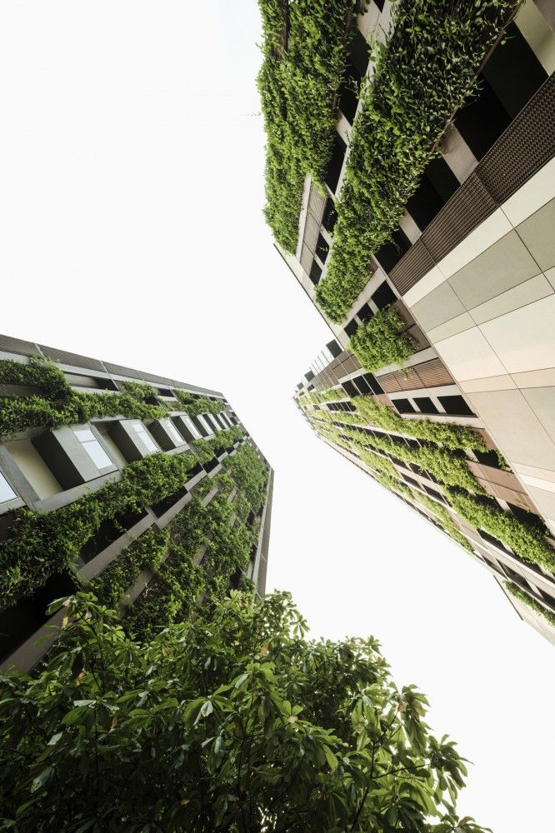

LANDSCAPE OPEN SPACE AND VERTICAL GREENERY
  Green plot ratio: 3D volume of project covered by plants
  Outdoor space greater than 30% of site area, of which 25% must be vegetated
  None
  None

Slide 14
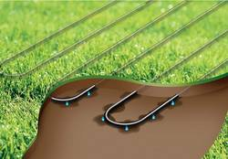
LANDSCAPE IRRIGATION
  Efficient irrigation systems and drought tolerant plants
  Efficient irrigation systems, native or adapted plants, water source, no irrigation
  Efficient irrigation systems, plants for hot and dry climate, water source, no irrigation, manual irrigation
  Efficient irrigation systems, no irrigation
* Green Mark awards alternative water sources separately, Green Star awards rainwater use separately

Slide 15
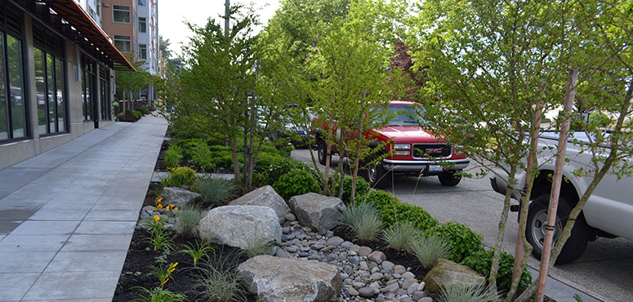
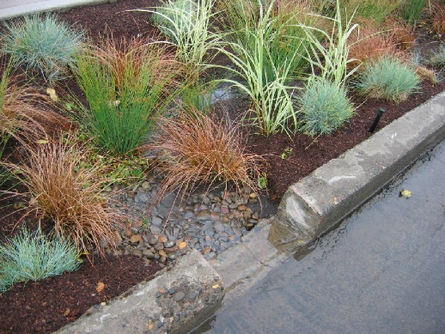
STORMWATER MANAGEMENT
  Treatment through infiltration or design features to reduce storm surges and treat water
  Process and manage rainwater for 95th percentile of storms on-site in a manner replicating natural site hydrology processes.
  Peak run-off rate does not increase post-development using infiltration of sustainable urban drainage techniques
  Peak run-off rate does not increase post-development
* Green Mark awards alternative water sources separately, Green Star awards rainwater use separately

Slide 16
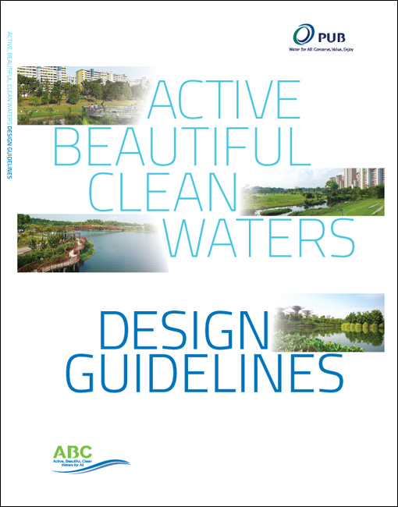
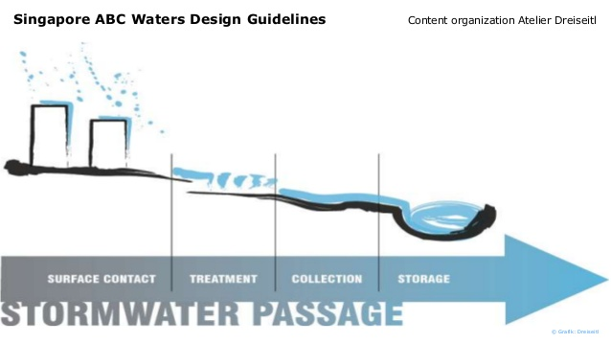

Slide 17
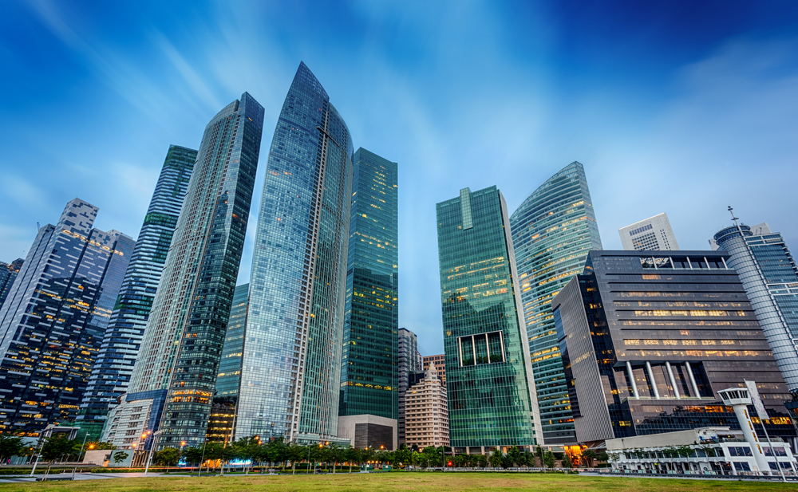
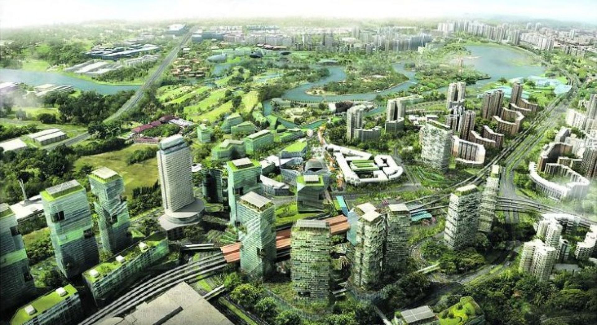

Slide 18

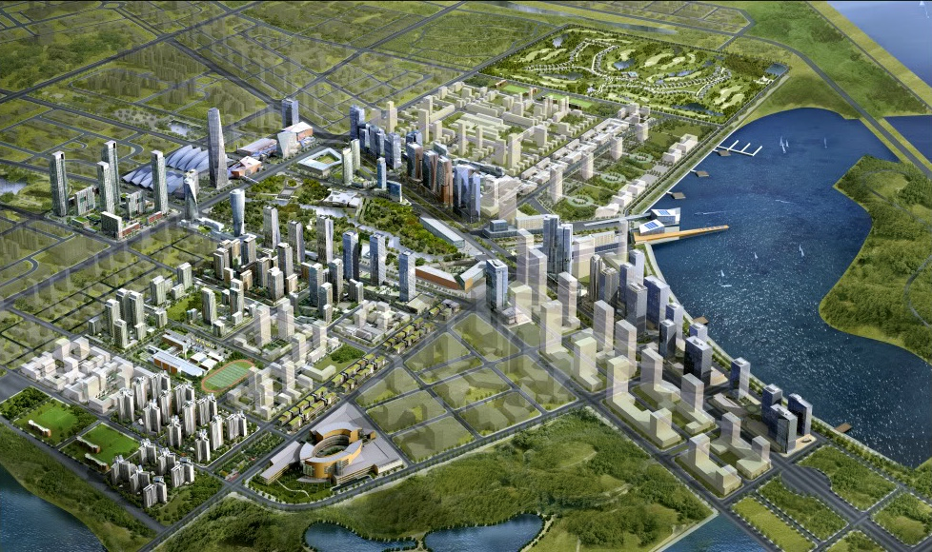
Rating system integrating the principles of smart growth, urbanism and green building to award sustainable neighborhood design
Similar in intent to BREEAM Communities, Green Mark Districts, Green Star Communities
Credit categories:
  Smart location and linkage
  Neighborhood pattern and design
  Green infrastructure and buildings

Slide 19
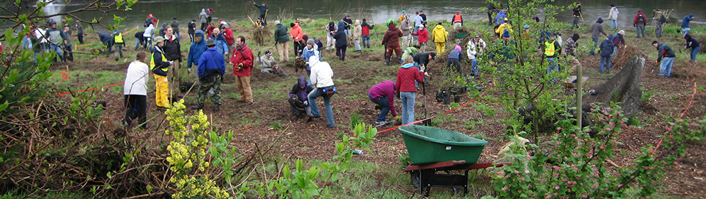
Smart location and linkages
Imperiled species and ecological communities – Habitat conservation plan
Steep slope protection – Restore previously developed slopes greater than 15% with native or non-invasive adapted plants
Site design for habitat or wetlands – conserve 100% of water bodies and do not disturb significant habitat
Restoration of habitat or wetlands – Use native plants to restore 10% of predevelopment native ecological communities
Long term conservation management of habitat – Create a 10 year management plan for existing and restored native habitats including personnel, costs and funding

Slide 20
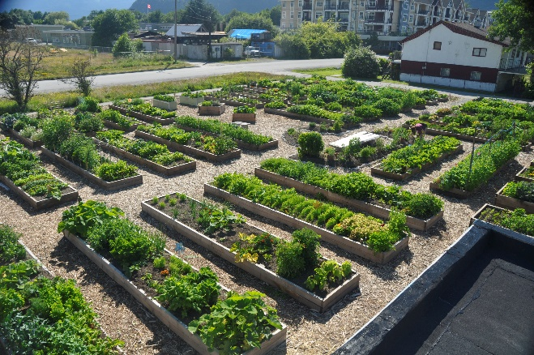
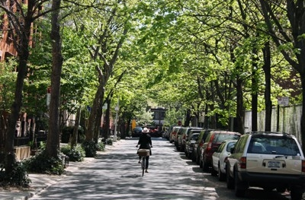
Neighborhood pattern and design
Access to civic and public space – Provide square, park or plaza of at least 675 m2 within 400 meters of 90% of building entrances
Local food production – Dedicate permanent and viable growing space. Ensure solar access, fencing, watering systems, garden bed enhancements, tool storage, pedestrian access
Tree-lined and shaded streetscapes
  Provide trees every 12 meters along streets between road and walkway
  Provide shade from trees over 40% of sidewalks
  Demonstrate planting details are appropriate to growing healthy trees

Slide 21
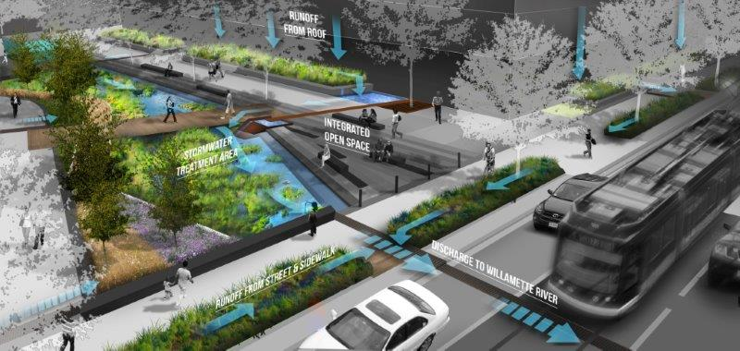

Slide 22
IS THERE A RATING SYSTEM WITH A STRONG LANDSCAPE FOCUS?

Slide 23
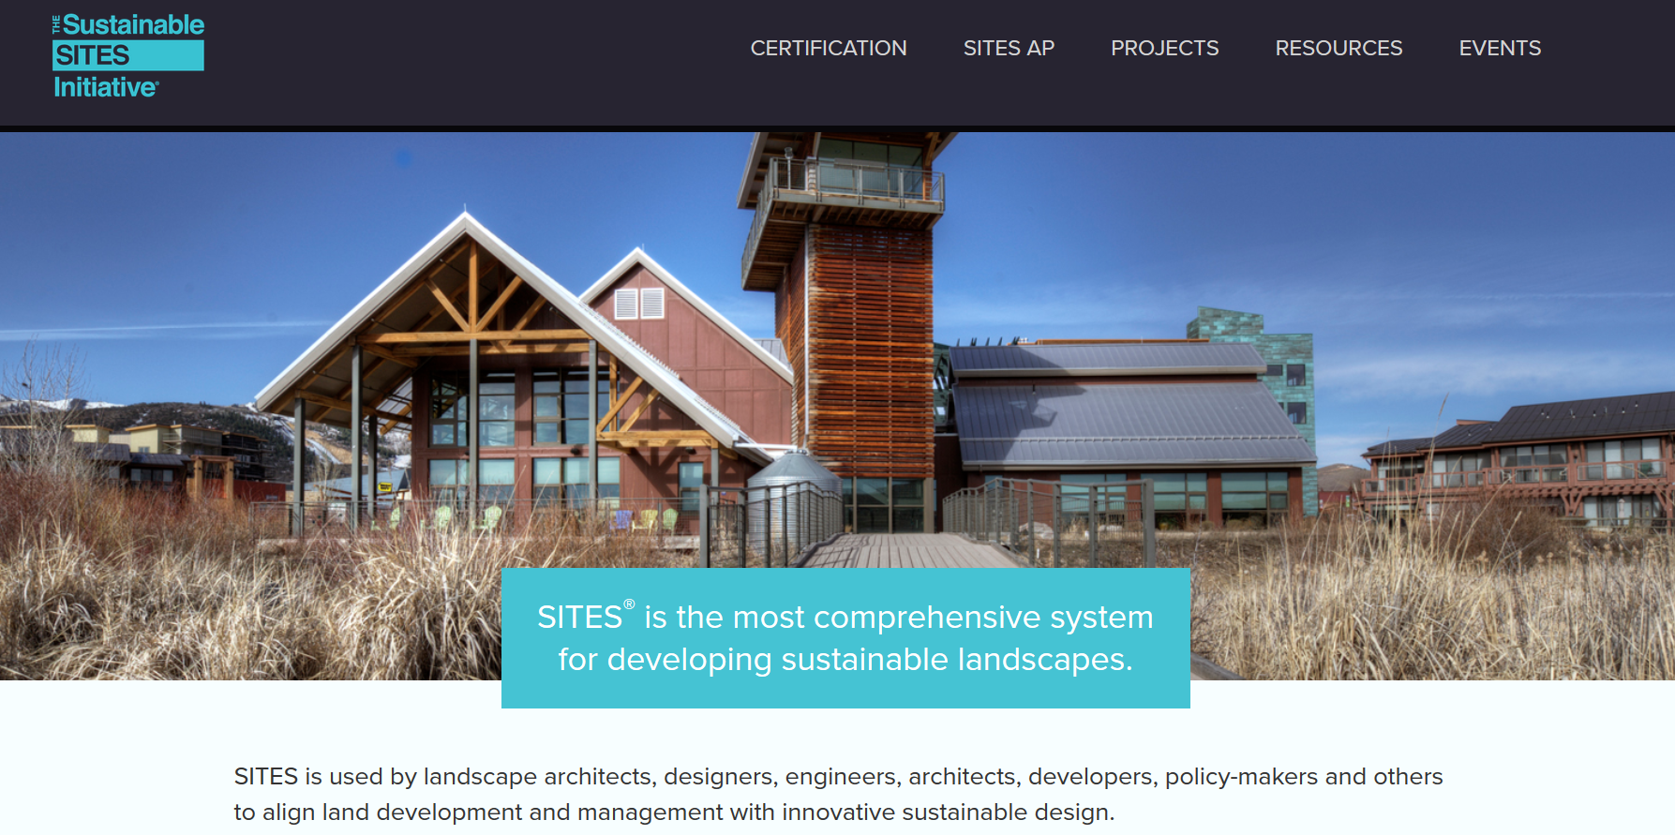

Slide 24
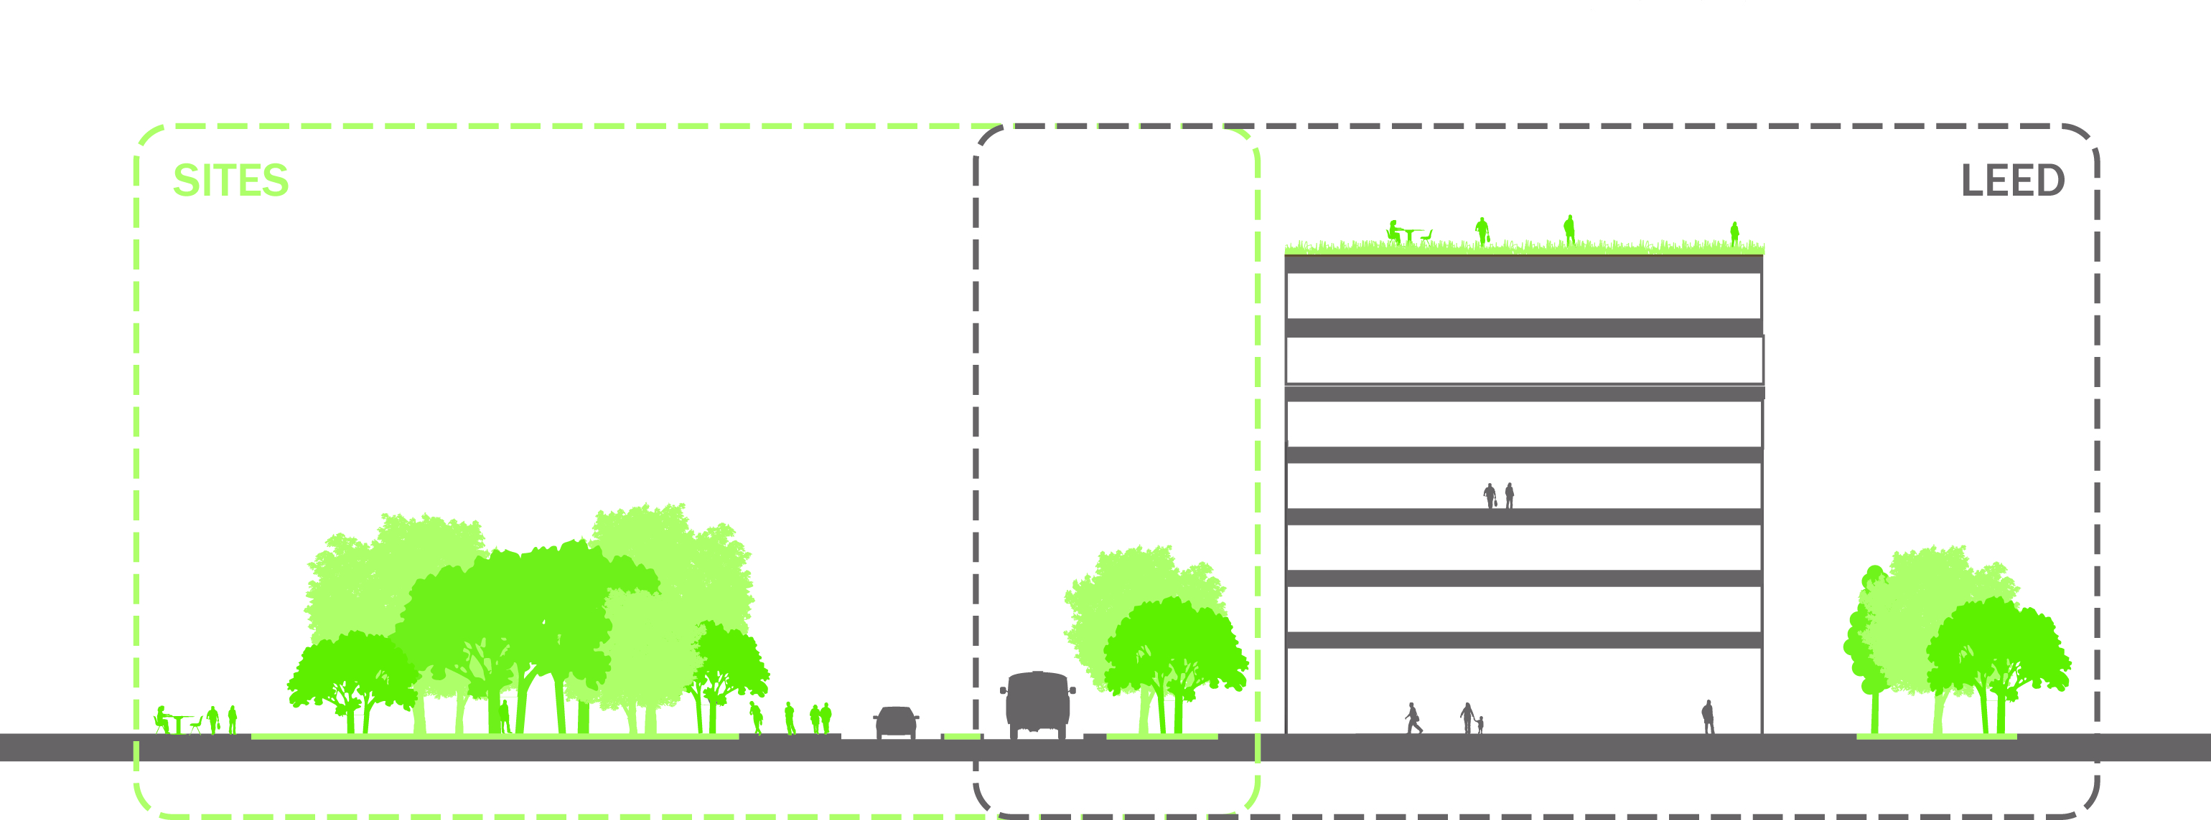
GREEN MARK PARK
GREEN MARK 2015

Slide 25
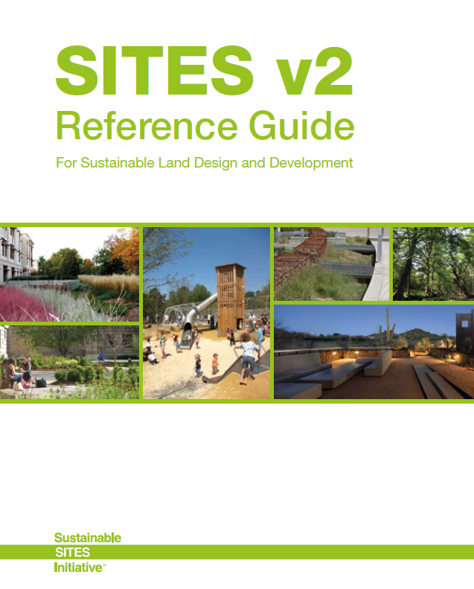
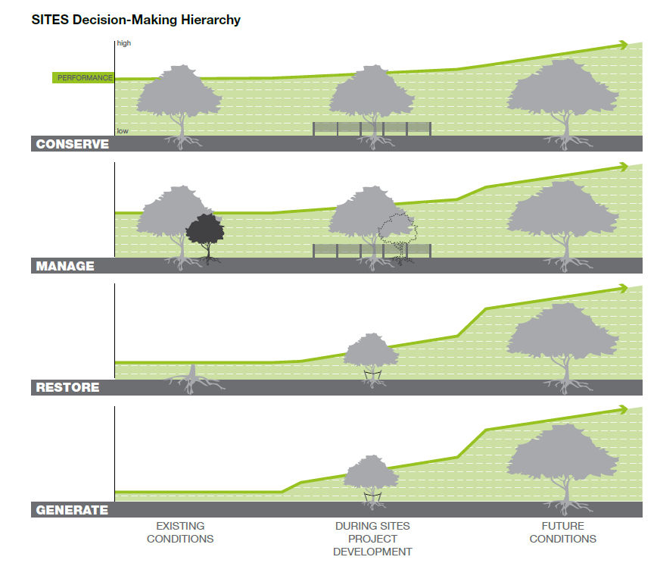

Slide 26
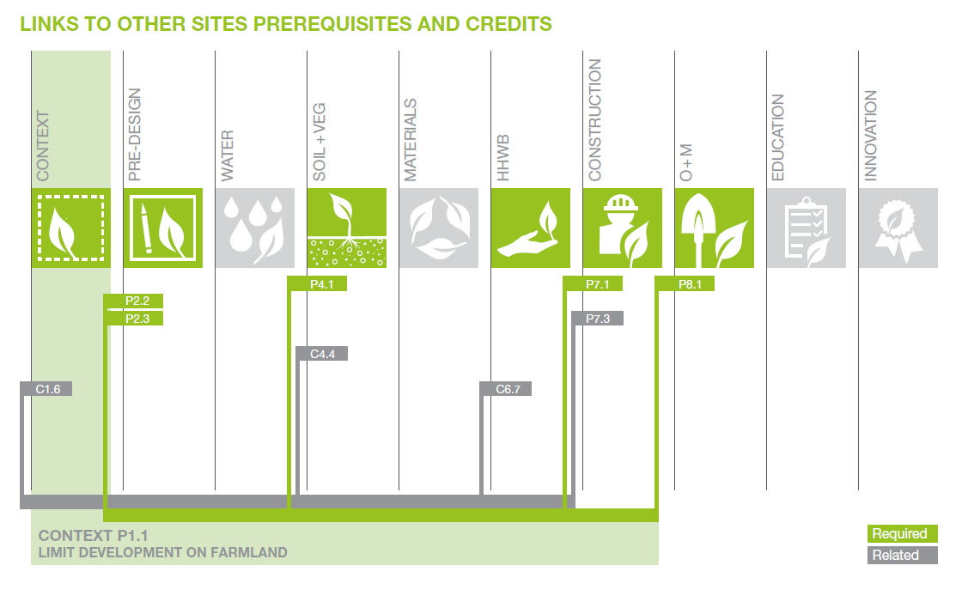

Slide 27
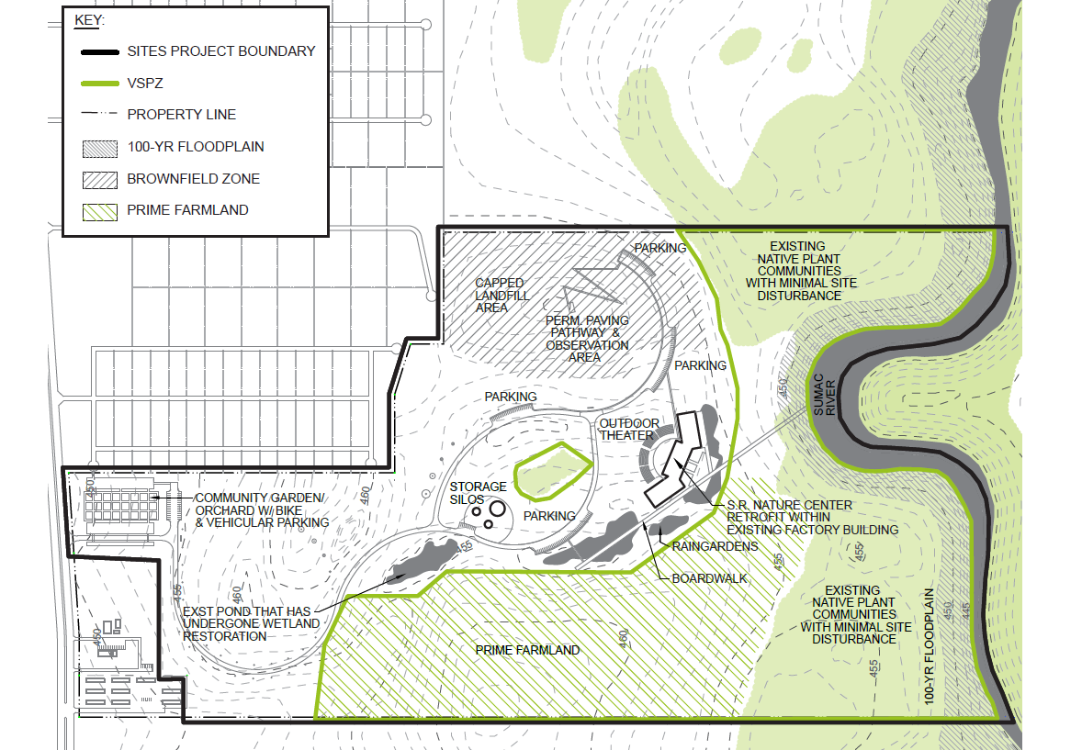
VEGETATED SOIL PROTECTION ZONE PLAN (VSPZ)

Slide 28
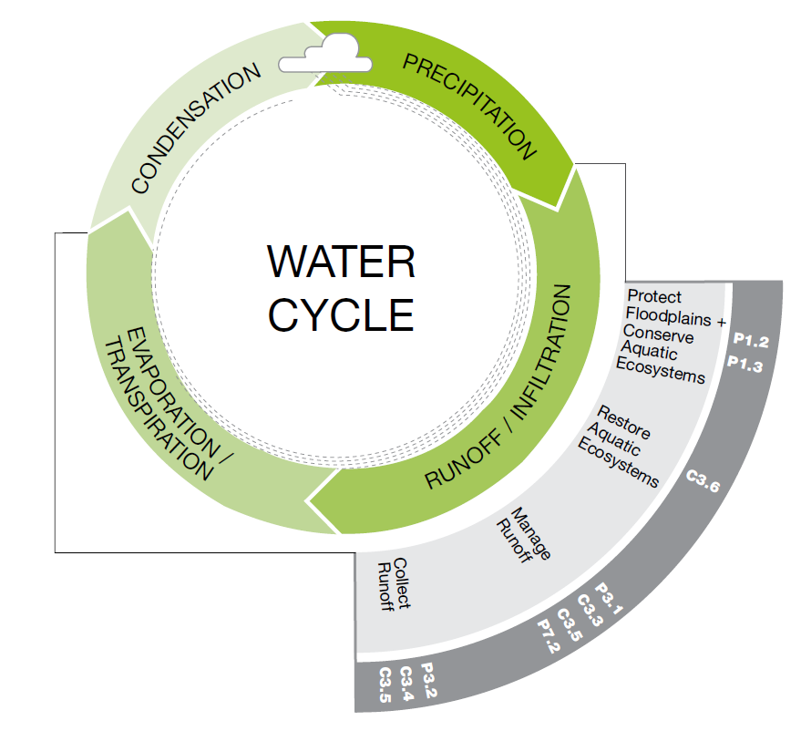

Slide 29
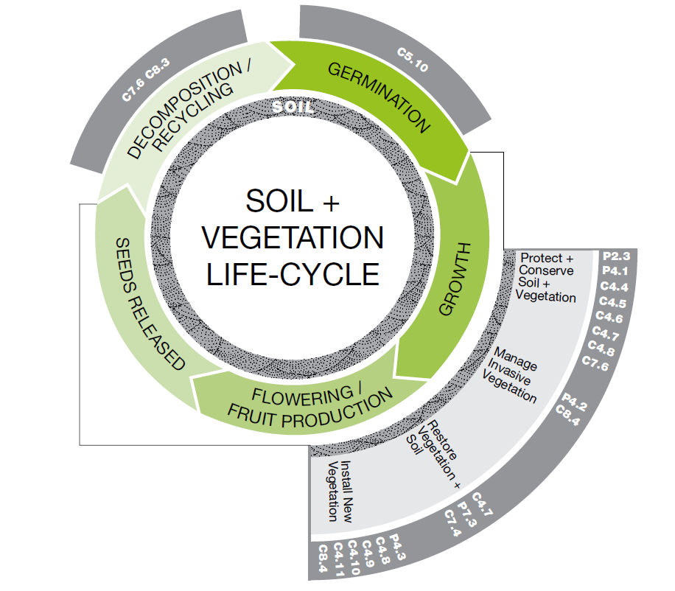

Slide 30
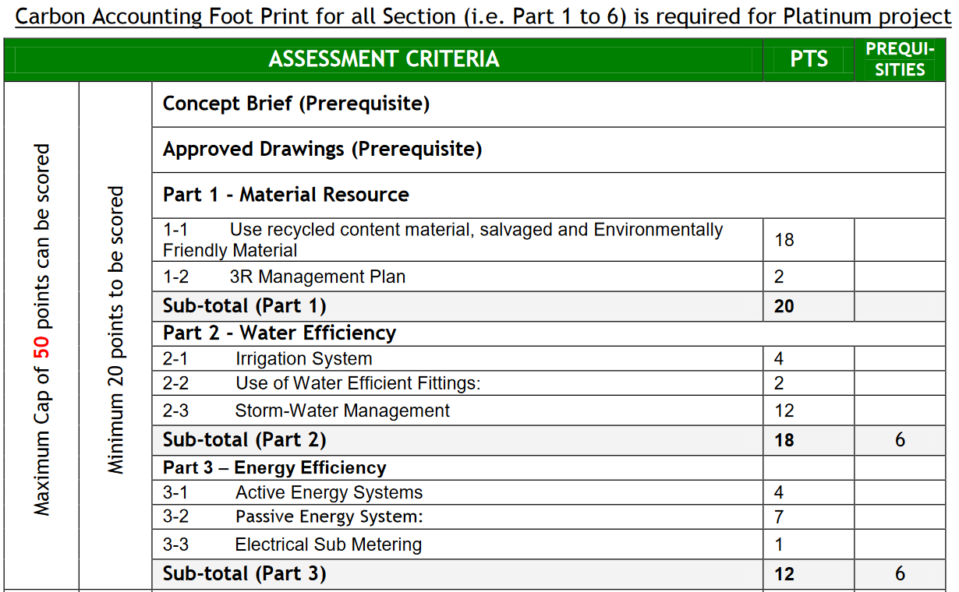
BCA GREEN MARK PARK

Slide 31
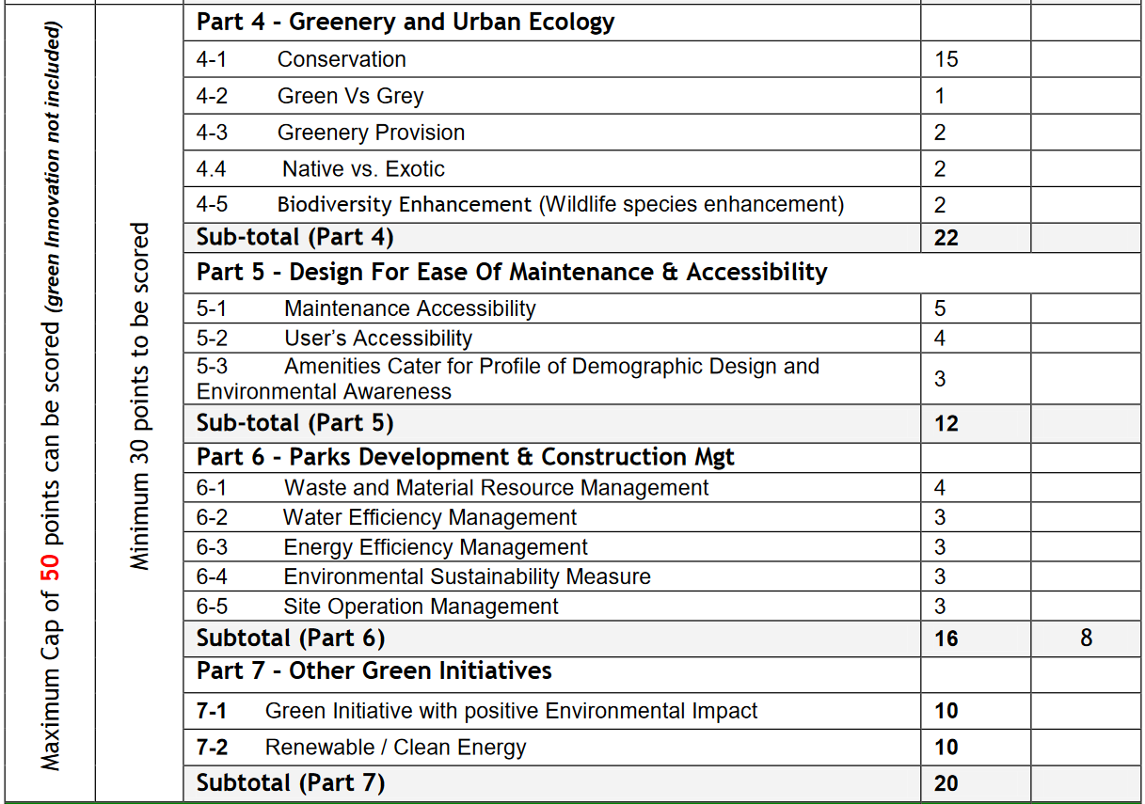

Slide 32
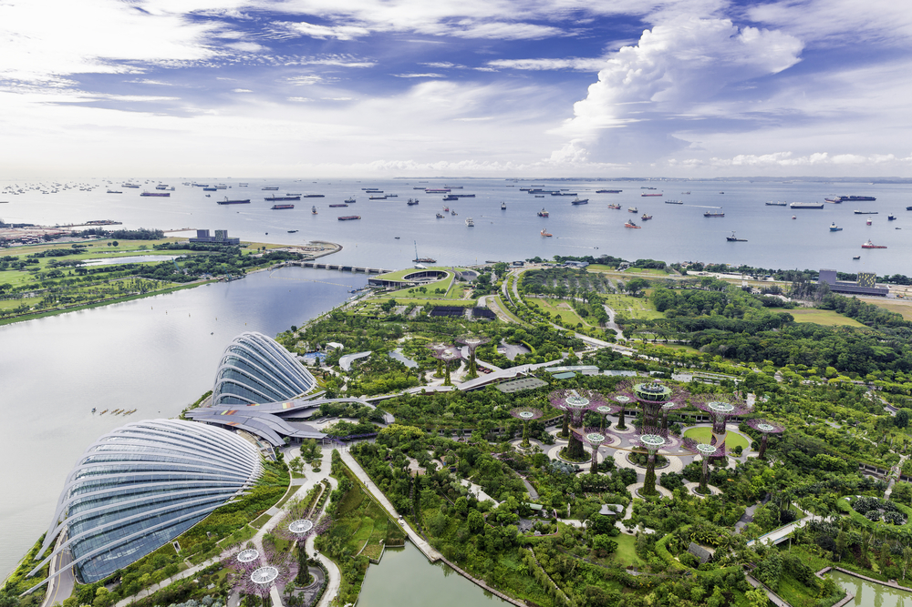

Slide 33
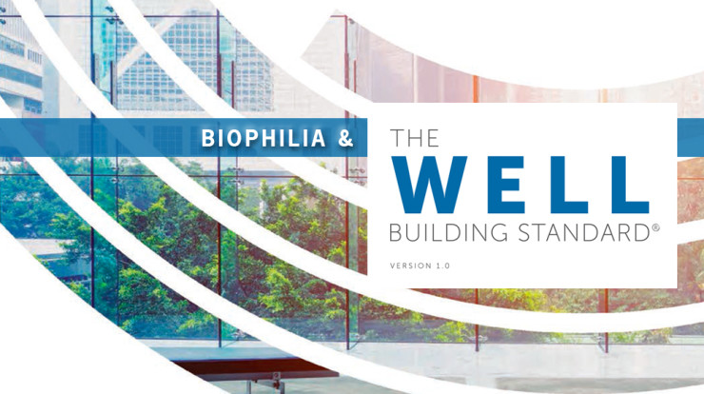

Slide 34
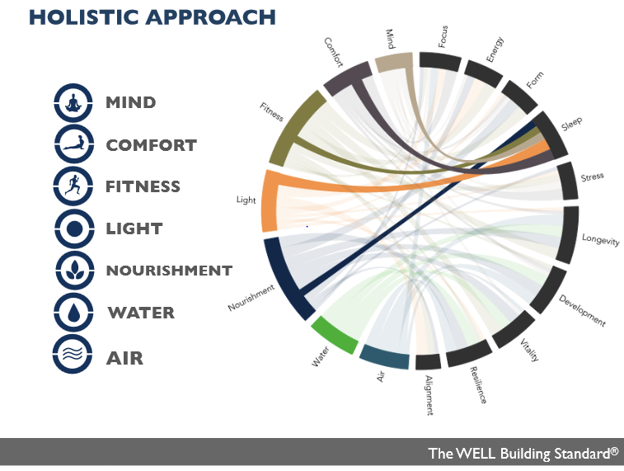

Slide 35
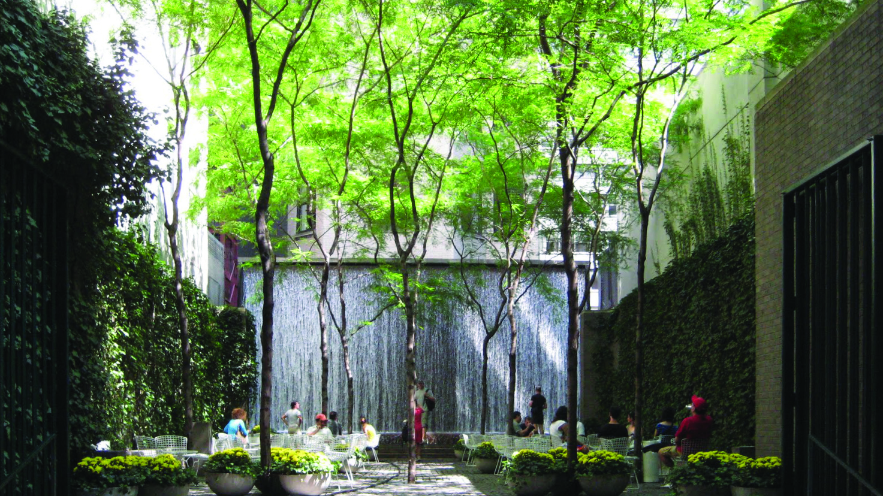
Biophilic Design – A design trend that focuses on the human connection between nature and the built environment.

Slide 36
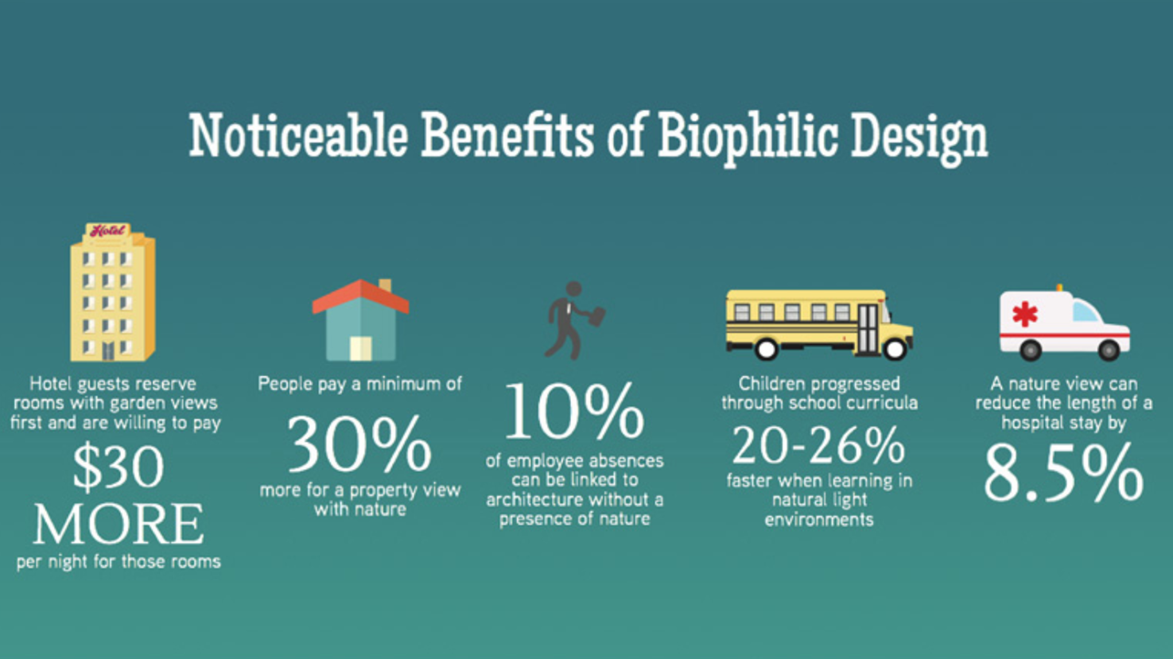

Slide 37
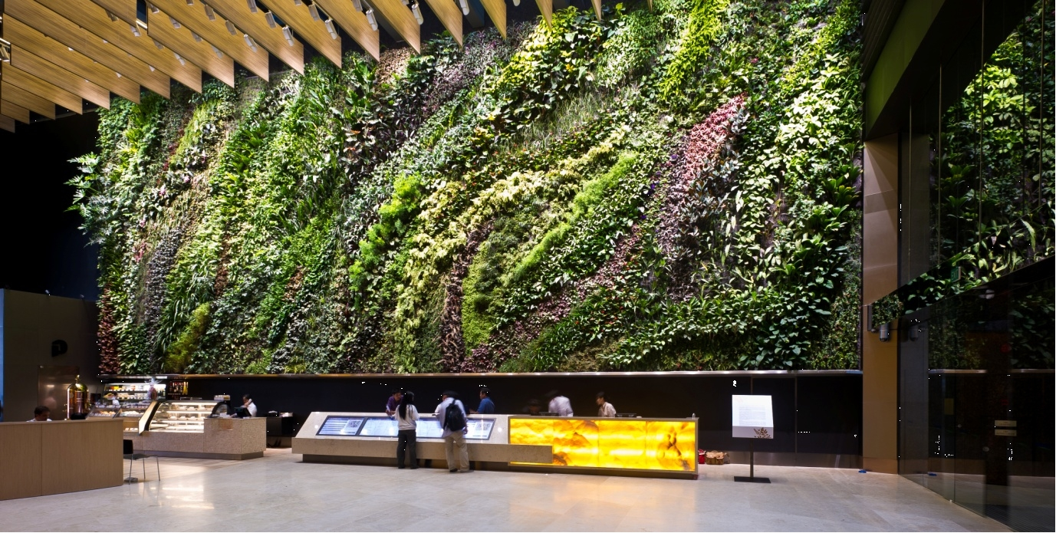
Notes:
Biophilia I – Qualitative biophilia plan:
Incorporates nature through environmental elements, lighting, space layout
Describes how the project incorporates nature’s patterns throughout the design
Provides opportunities for human-nature interaction inside and outside the building

Slide 38
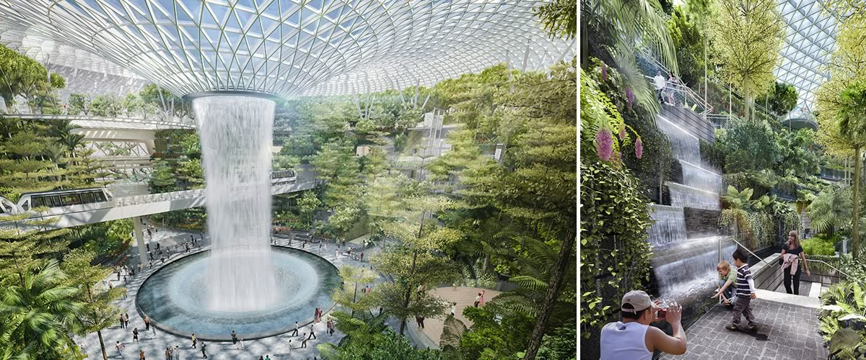
Notes:
Outdoor biophilia – 25% of site area features landscaped grounds or accessible rooftop gardens or consists of 70% plantings
Indoor biophilia – Potted plants cover 1% of each floor’s area and a plant wall per floor (at least 2% of floor area)
Water feature – 1 water feature per 100,000 sqft.

Slide 39
Approach from a holistic point of view
Synergies across strategies
Focus on human connection with nature

Slide 40
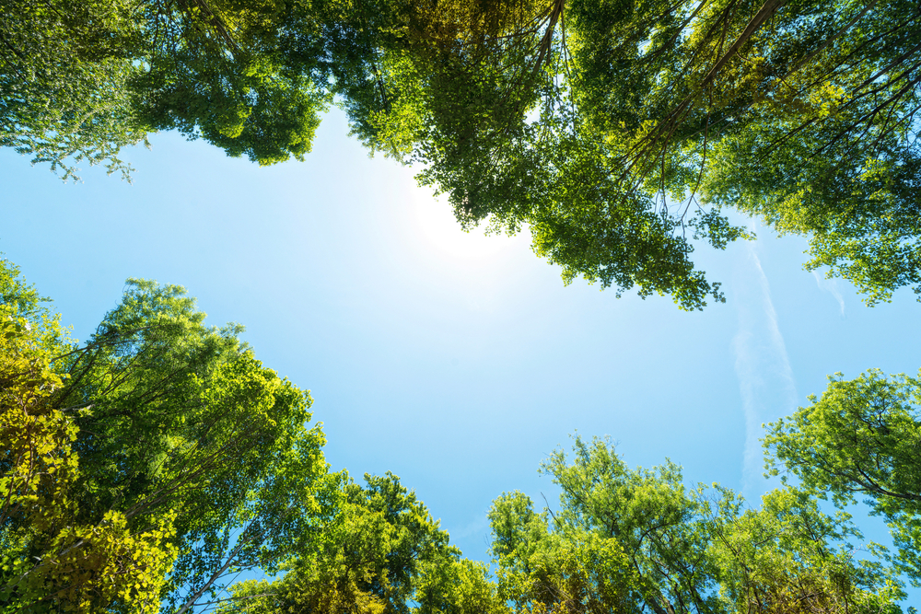
THANK YOU

